Slide 1
Welcome to
Keira Roberts’
Math 2412 si
Please sign in on the orange sheet at the front.
Grab a copy of today’s worksheet and a piece of graph paper.

Slide 2
Agenda
Introduction
Warm Up
Worksheet
Activity

Slide 3
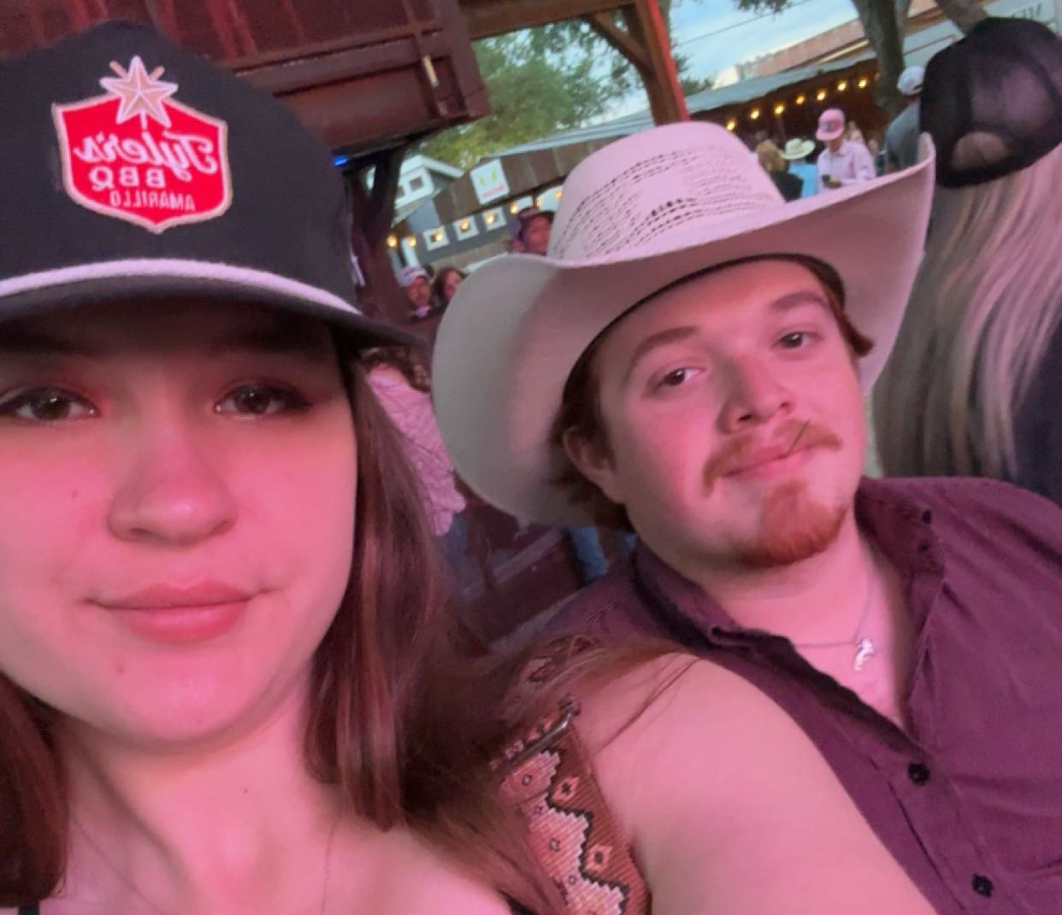
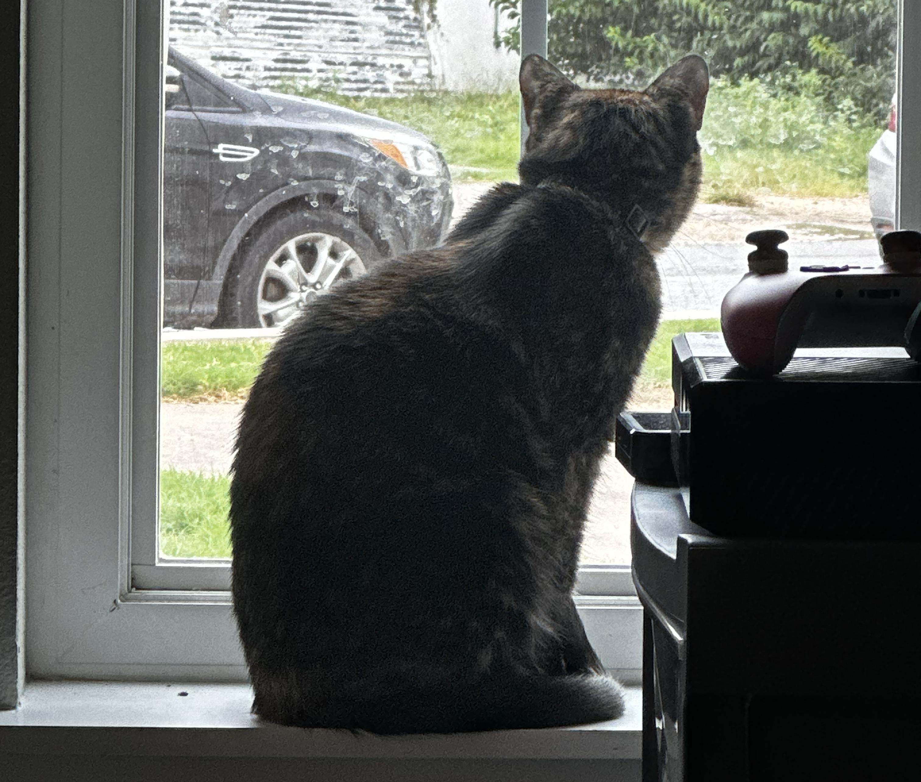
Introduction
I am…
a Junior Mathematics major with a focus in Biomathematics
planning to pursue my masters at Tarleton in Agricultural and Natural Resource Sciences
hoping to work in data analysis for a conservation agency
very excited to get to know you and help you learn!!

Slide 4

Warmup

Slide 5
Worksheet

Slide 6
Piecewise functions graphing activity

Slide 7
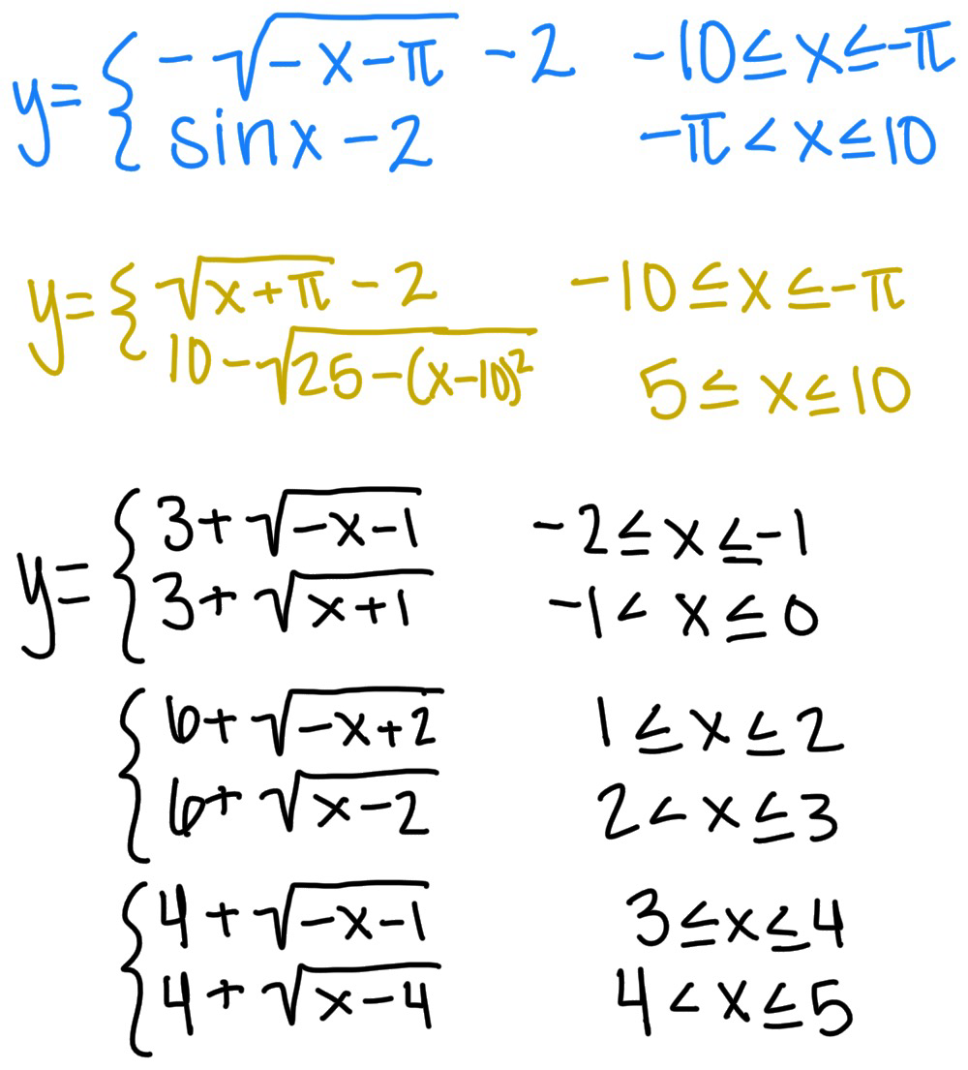
Graph these equations on your own paper

Slide 8
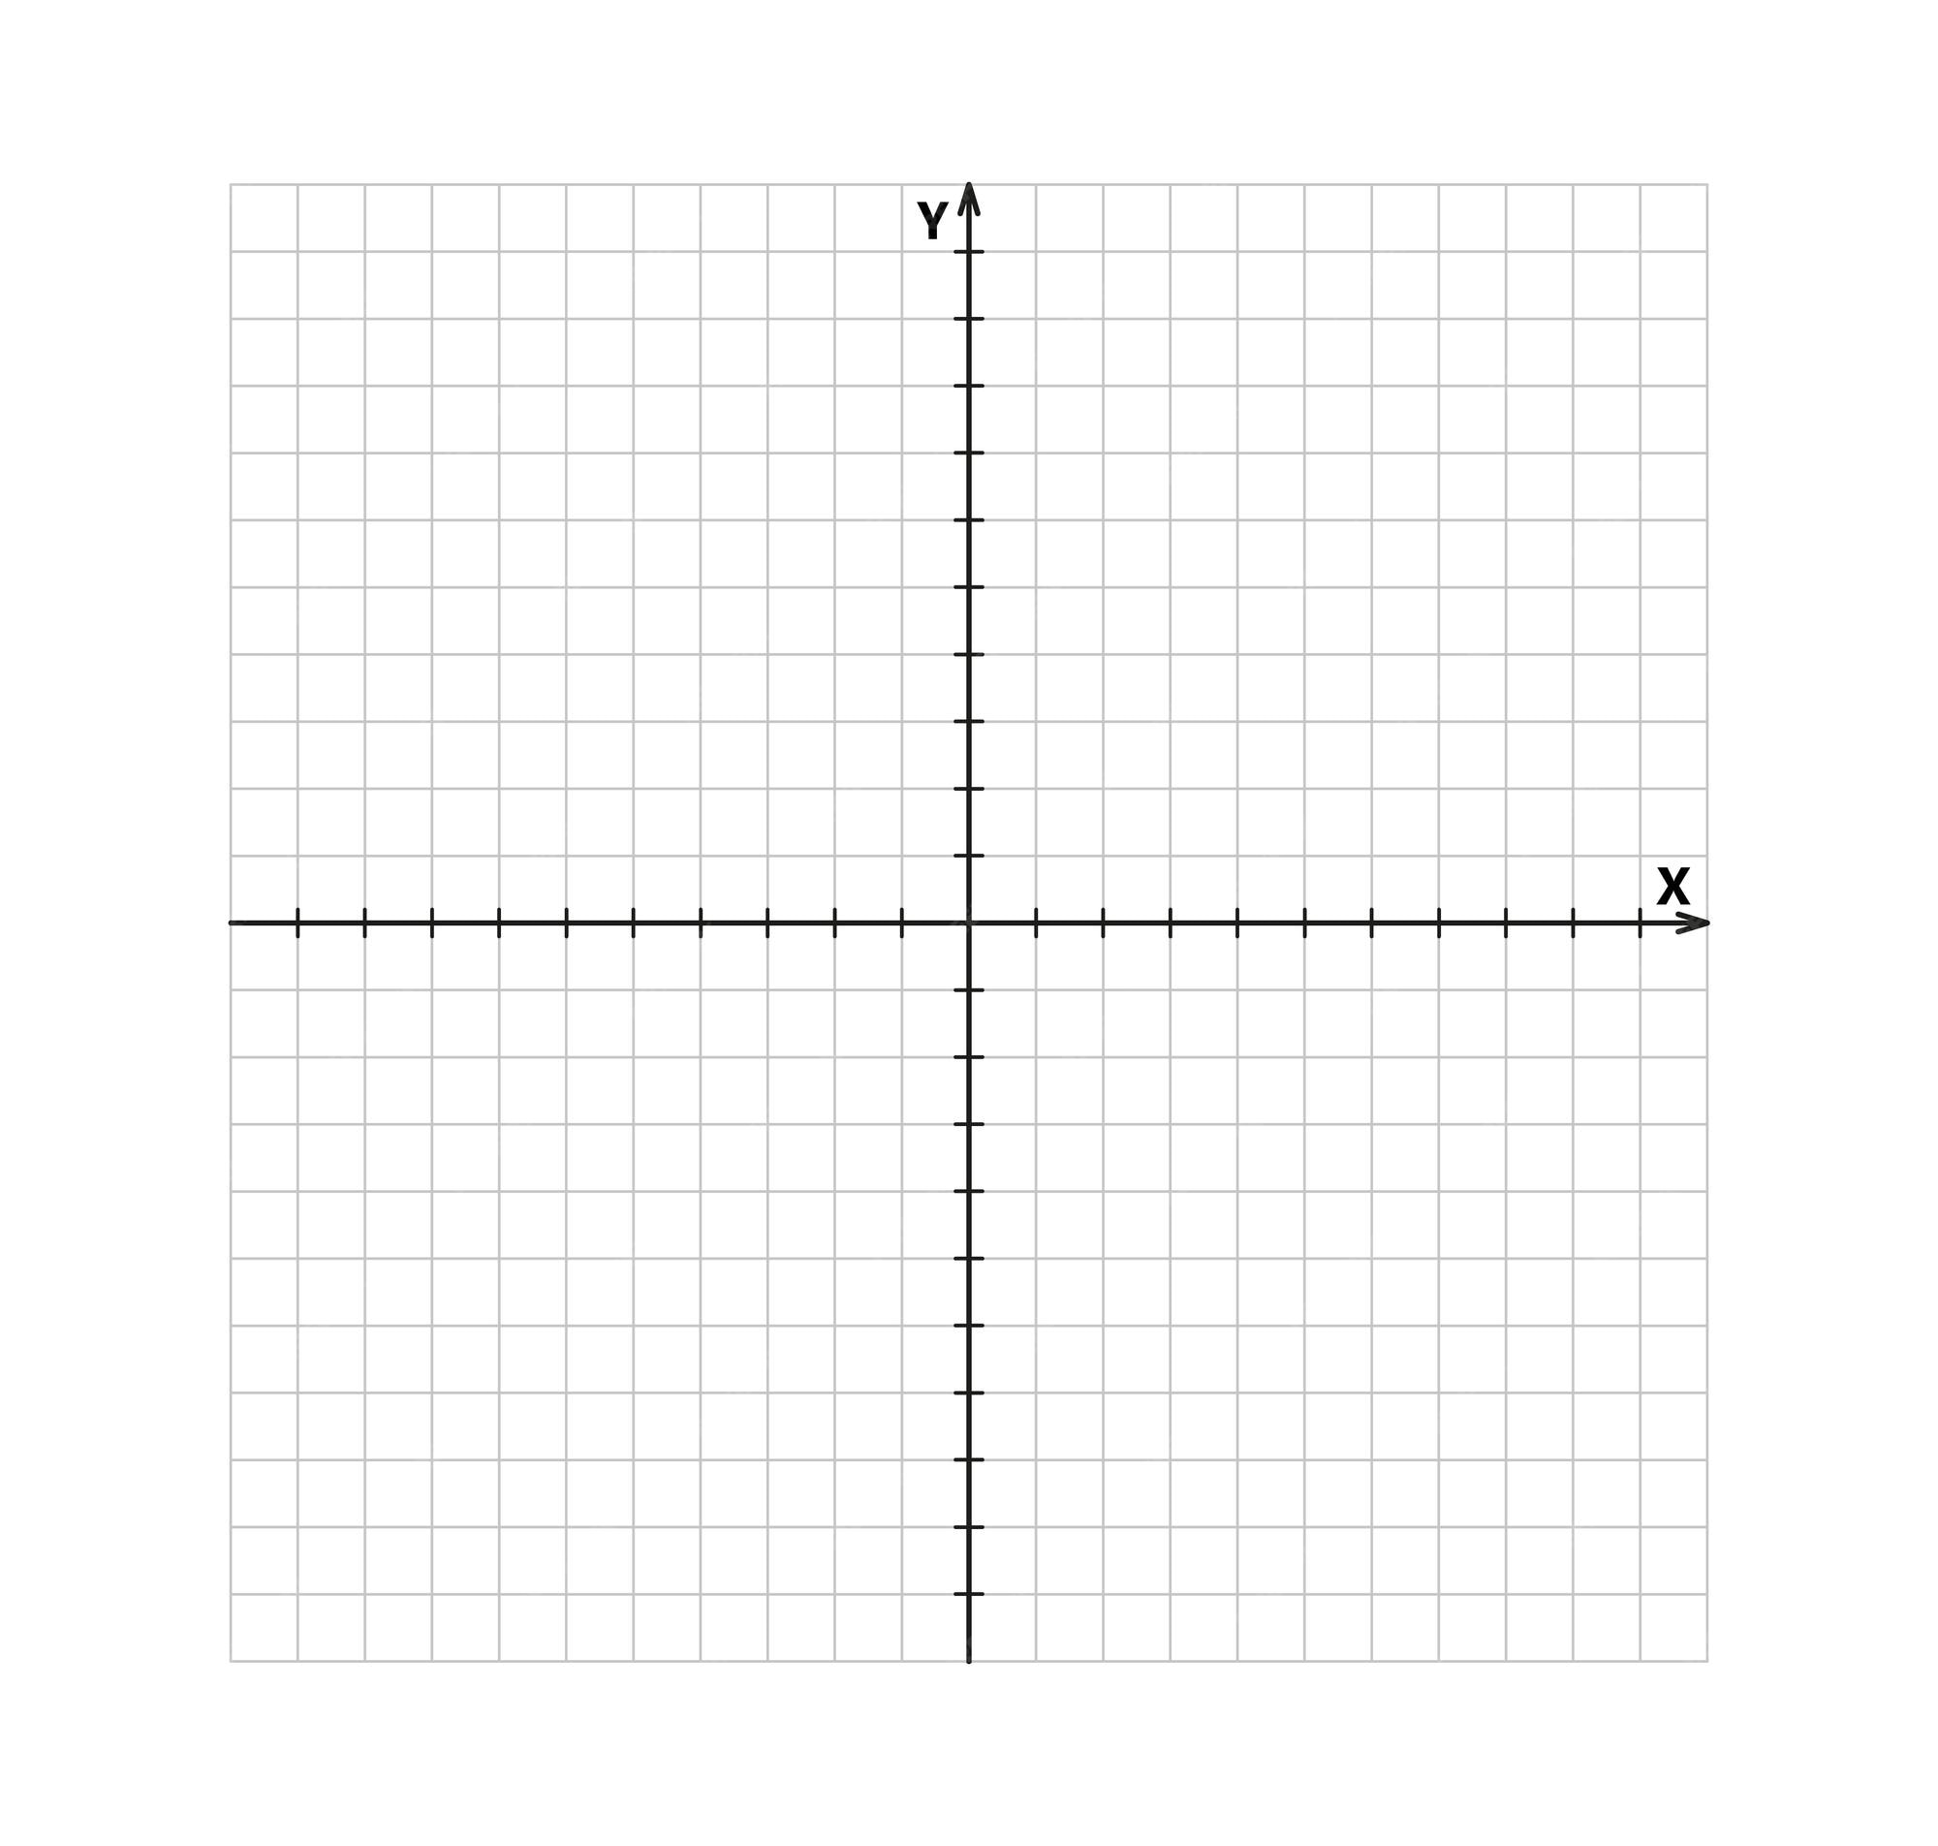

Slide 9
Announcements
Regular session next week Monday, 9/8 in Math 112 from 4-5 pm
Test Prep session on Wednesday, 9/10 in Math 112 from 4-6 pm
-Test Prep sessions are longer because we will be reviewing content
from the entire chapter. If you are unable to make my Test Prep, the
other Precalculus SI’s will be hosting Test Preps on Monday and Tuesday.

