Slide 1
Welcome to
Keira Roberts’
Math 2412 si
Warmup: Hangman
__ __ __ __ __ __ __ __ __ __
__ __ __ __ __ __ __ __
Please sign in on the orange
sheet at the front and grab
a copy of the worksheet.
A B C D E F G
H I J K L M
N O P Q R S T
U V W X Y Z
Notes:
Difference Identities

Slide 2
Trig worksheet

Slide 3
Whiteboard race activity

Slide 4
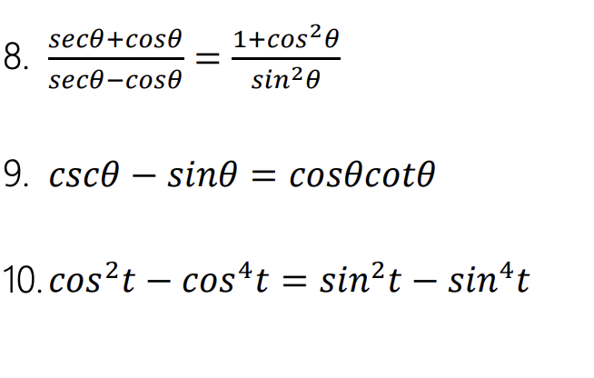
Extra practice

