Slide 1
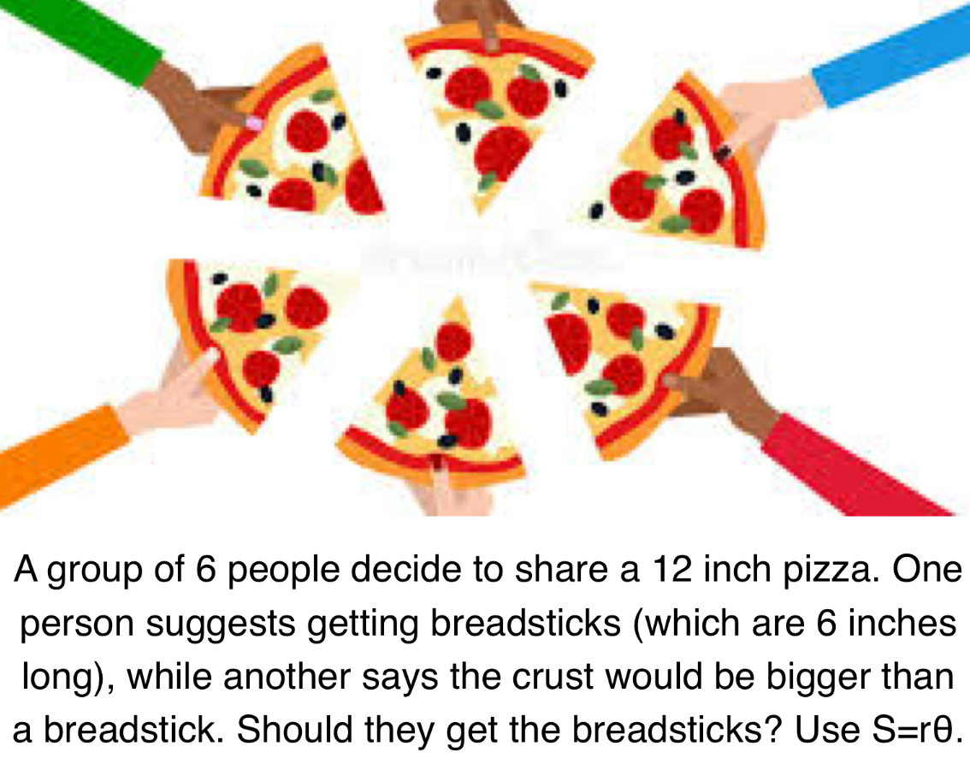
Please sign in on the orange sheet at the front, grab a copy of the worksheet, and solve Today’s warmup question:
Welcome to
Keira Roberts’
Math 2412 si

Slide 2
ARC Length Worksheet

Slide 3
key teRms Activity

Slide 4
Night Against Procrastination
Tuesday, October 7th 5-10pm
in the Library Basement
- Ask questions about course content, or we can help you
create a study plan if we do not have an si/tutor

