Slide 1
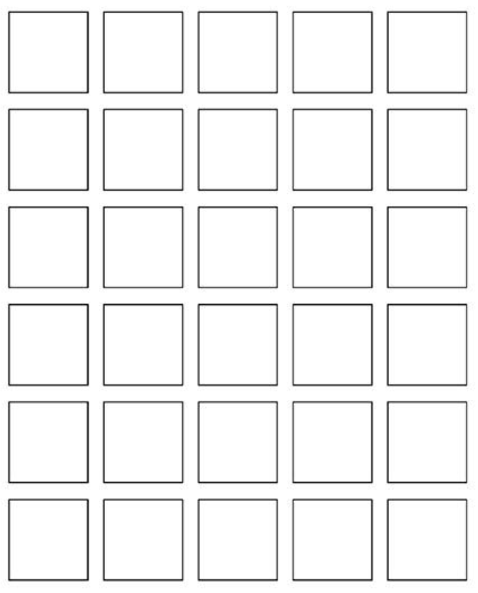
Welcome to
Keira Roberts’
Math 2412 SI
Warmup: Wordle
Please sign in on the orange
sheet at the front and grab
a copy of the worksheet
and a bingo card.
A B C D E F G
H I J K L M
N O P Q R S T
U V W X Y Z
Notes:
Final

Slide 2
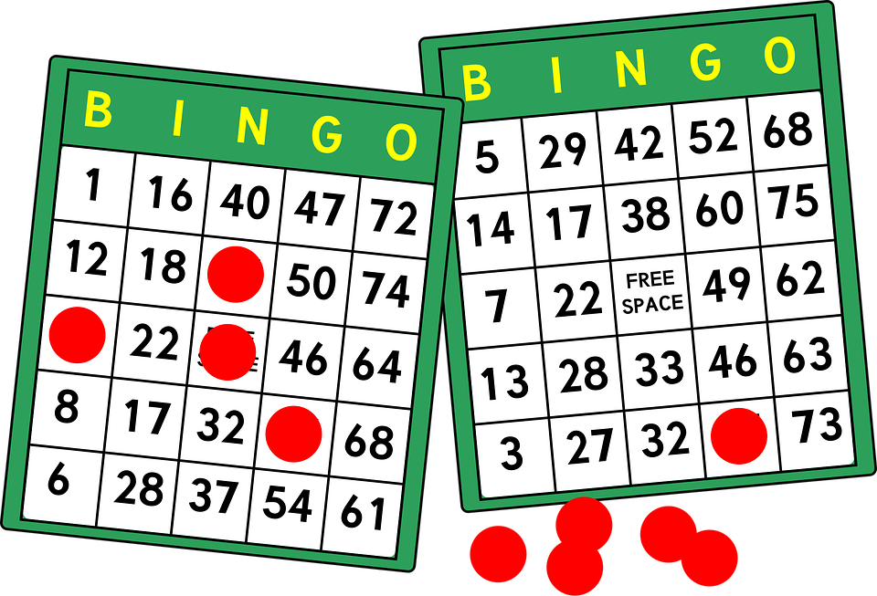
Vector Bingo

Slide 3

Find the Dot Product of the Vectors.

Slide 4

Tell if the vectors are Parallel, Orthogonal or Neither

Slide 5

Write the Resultant Vector as a Linear Combination.

Slide 6
Find the Magnitude of the Vector.

Slide 7

Find the Dot Product of the Vectors.

Slide 8

Tell if the vectors are Parallel, Orthogonal or Neither

Slide 9

Write the Resultant Vector as a Linear Combination.

Slide 10
Find the Direction Angle of the Vector.

Slide 11

Find the Dot Product of the Vectors.

Slide 12

Tell if the vectors are Parallel, Orthogonal or Neither

Slide 13
Find the Magnitude of the Vector.

Slide 14
Find the Direction Angle of the Vector.

Slide 15

Find the Angle Between the Vectors.

Slide 16

Find the Resultant Vector.

Slide 17
Find the Magnitude of the Vector.

Slide 18
Find the Direction Angle of the Vector.

Slide 19

Find the Angle Between the Vectors.

Slide 20

Find the Resultant Vector.

Slide 21
Find the Magnitude of the Vector.

Slide 22
Find the Unit Vector in the opposite direction of a.

Slide 23

Find the Angle Between the Vectors.

Slide 24

Find the Resultant Vector.

Slide 25
Find the Magnitude of the Vector.

Slide 26
Find the Unit Vector.

Slide 27
WORKSHEET

Slide 28
BLOOKET

Slide 29
SCHEDULE
Your unit 5 exam is on Tues 11/25!
Monday, November 24th-
Cydni’s Last Test Prep Session
6-8 pm in Math 135
What is FSP?
-free study help
-for MOST courses
-prepare for finals
-no appointment needed!
10 am to 5 pm
Tuesday, December 2nd- Finals Study Prep (FSP)
MATH 2412 specifically: 11 am - 5 pm
in the Tutoring & Learning Center (Library Basement)
*Please check in with the office and they will
get you connected with the right person!*
Wednesday, December 3rd- Finals Study Prep (FSP)
MATH 2412 specifically: 3:30 pm - 5 pm
in the Tutoring & Learning Center (Library Basement)
*Other MATH SI leaders and Math Tutors
should be available at any time 10 am – 5 pm!*
The FINAL EXAM for MATH 2412 is on FRIDAY, DEC 5th from 3:30 to 5:30 pm

