Slide 1
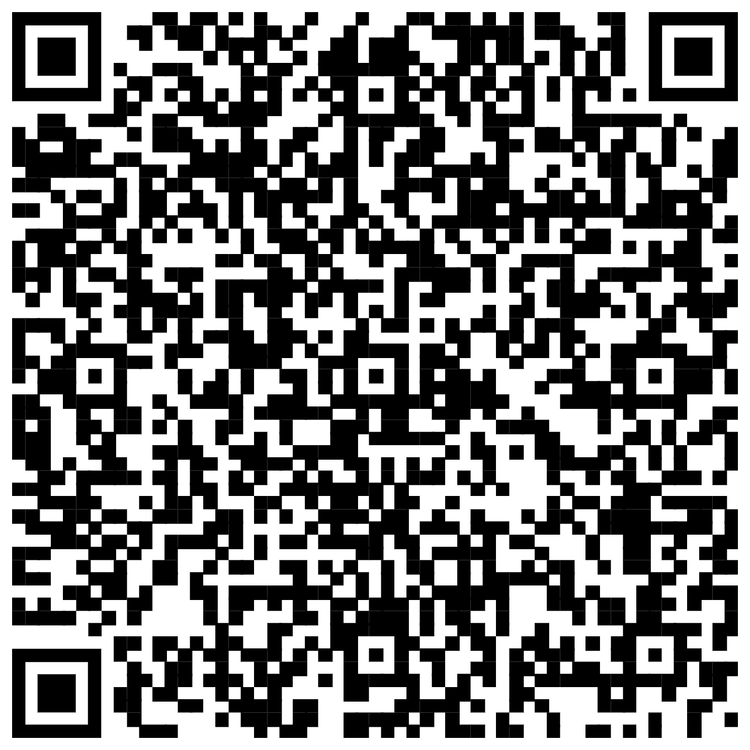
WELCOME TO
KEIRA Roberts’ math 2412 si test prep
Please sign in on the orange sheet at the front, grab a copy of the worksheet, and get started on today’s warmup by scanning the QR code.

Slide 2
AGENDA
Activity
Worksheet
Q & A

Slide 3
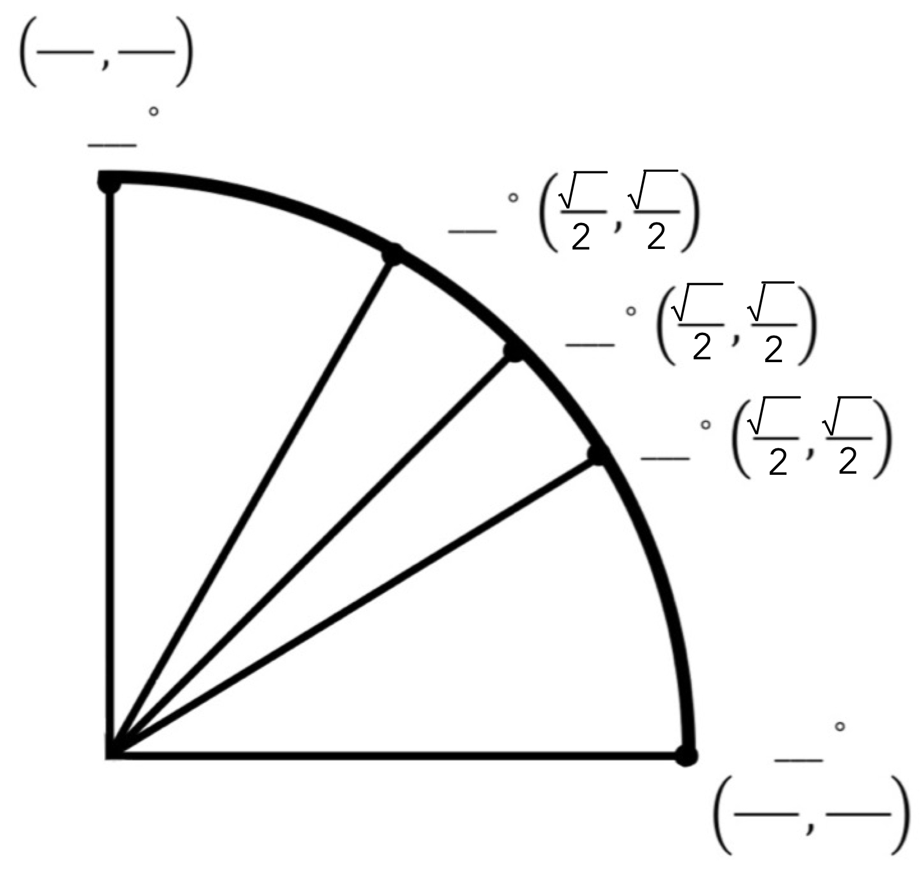
How to: Procedurally fill
The unit circle
Step One: fill in square root over 2

Slide 4
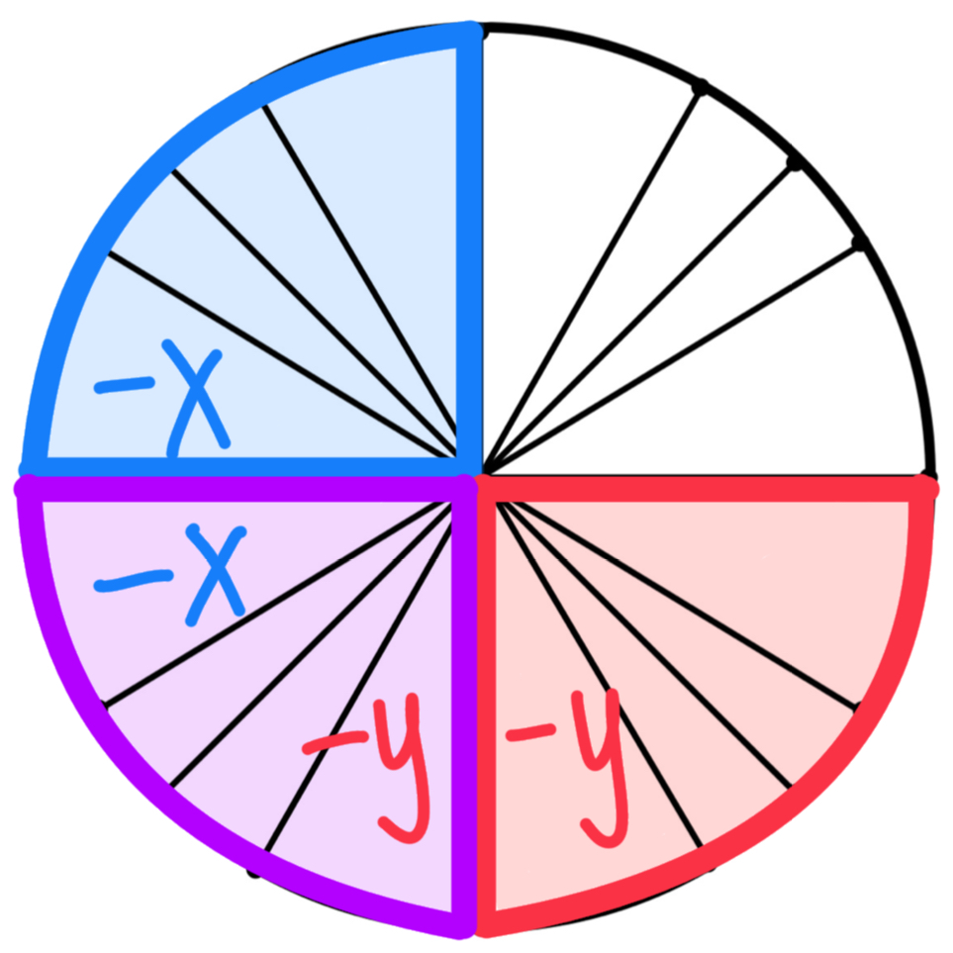
Step Two: fill in negative signs
Quadrant 1: ( x, y)
Quadrant 2: (-x, y)
Quadrant 3: (-x,-y)
Quadrant 4: ( x,-y)

Slide 5
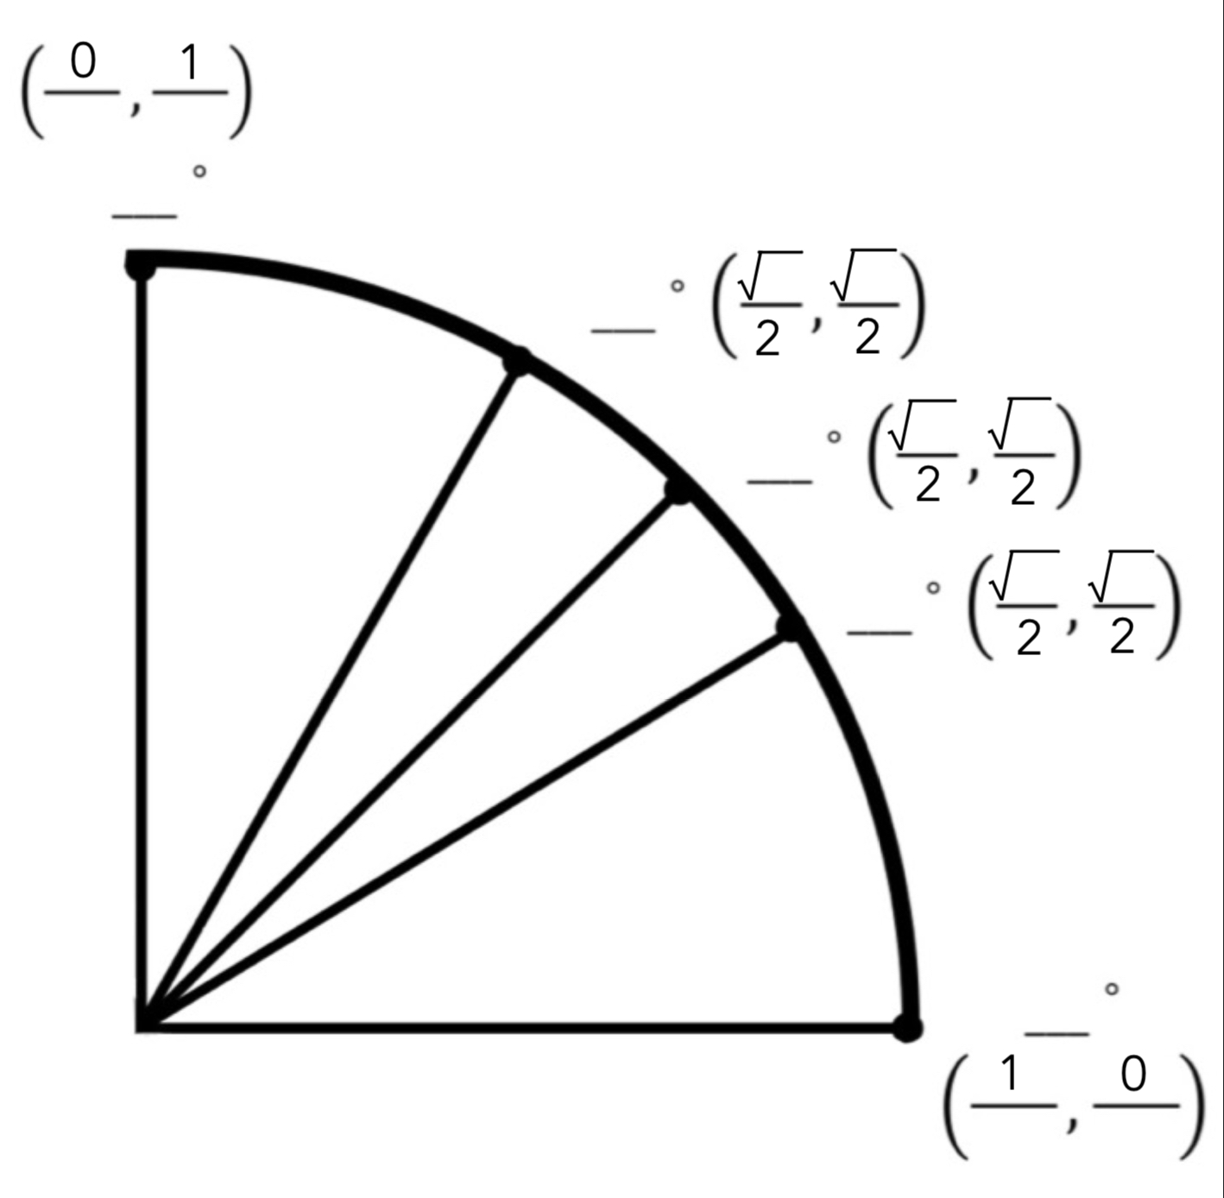
Step Three: fill in
( 1, 0)
(-1, 0) ( 0, 1)
( 0,-1)

Slide 6
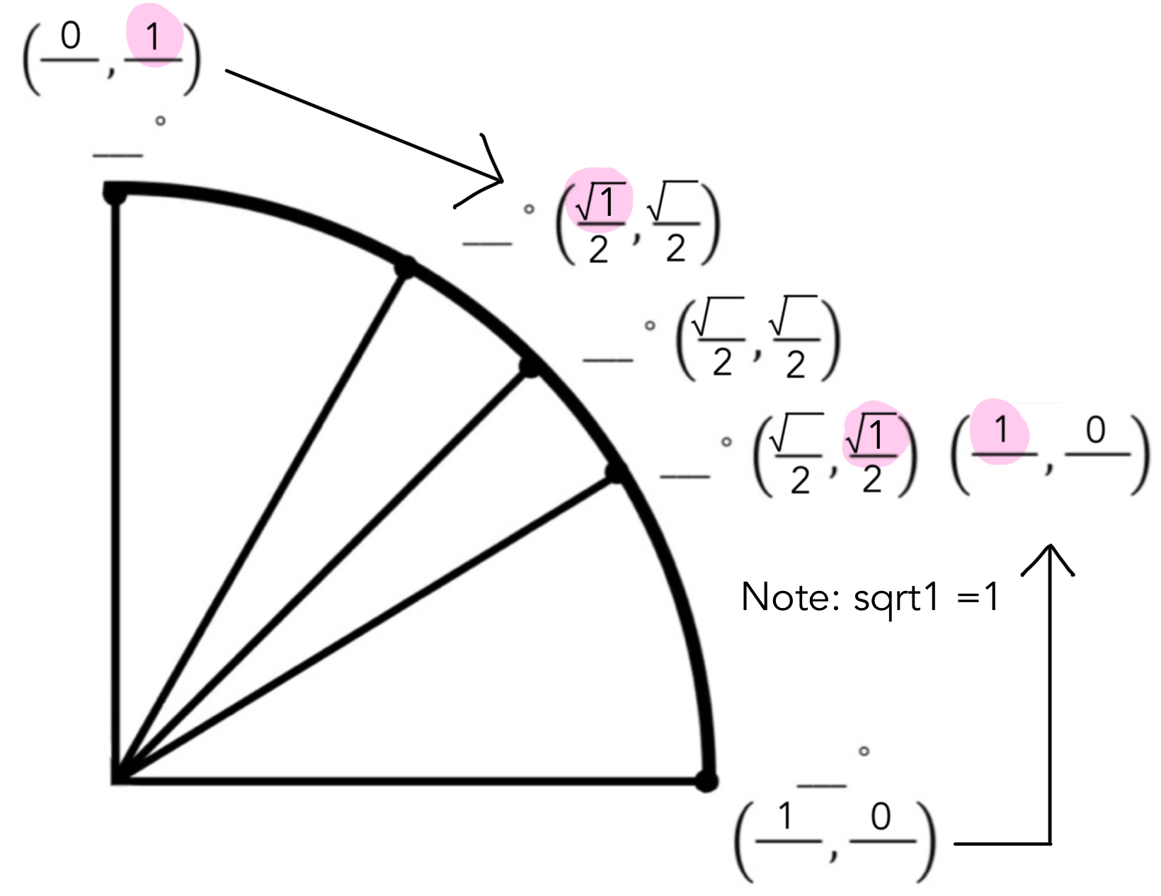
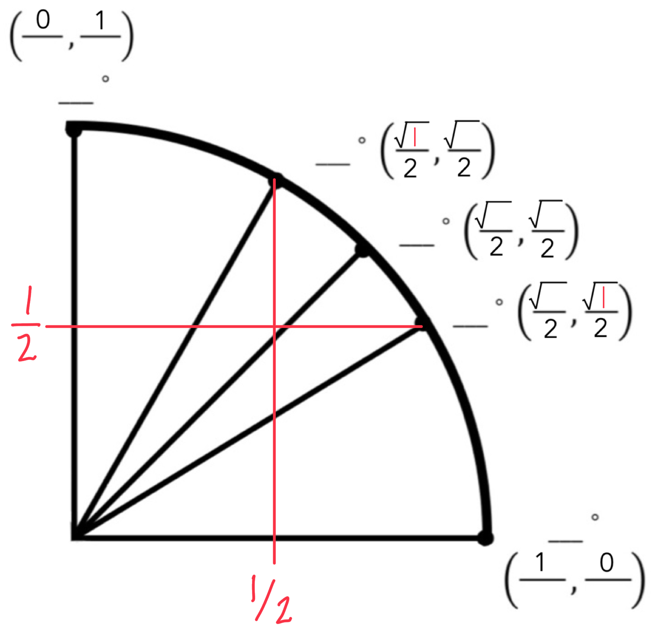
Step Four: 2 options to fill in 1’s
Option A: pair up 1’s
Option B: approximate ½’s

Slide 7
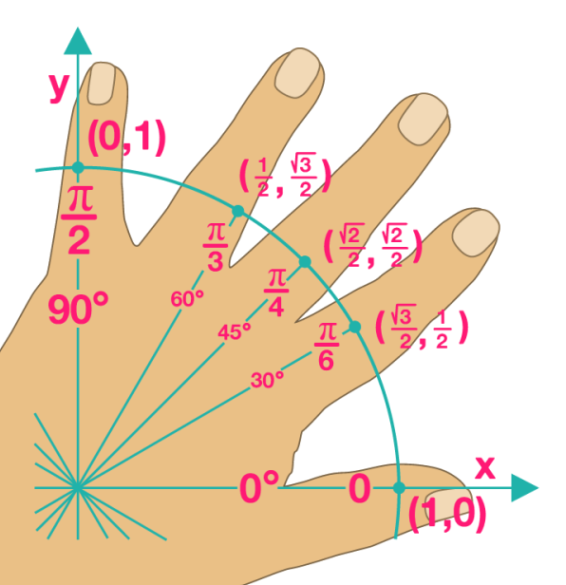
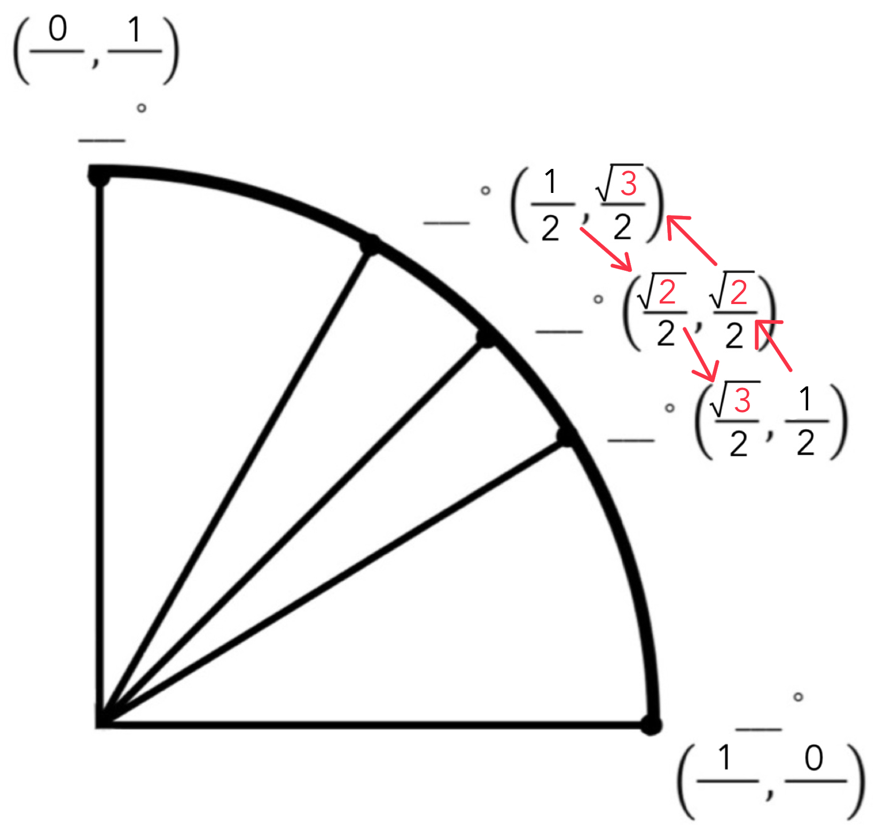
Step Five: 1 -> 2 -> 3
Or, use the left hand rule

Slide 8
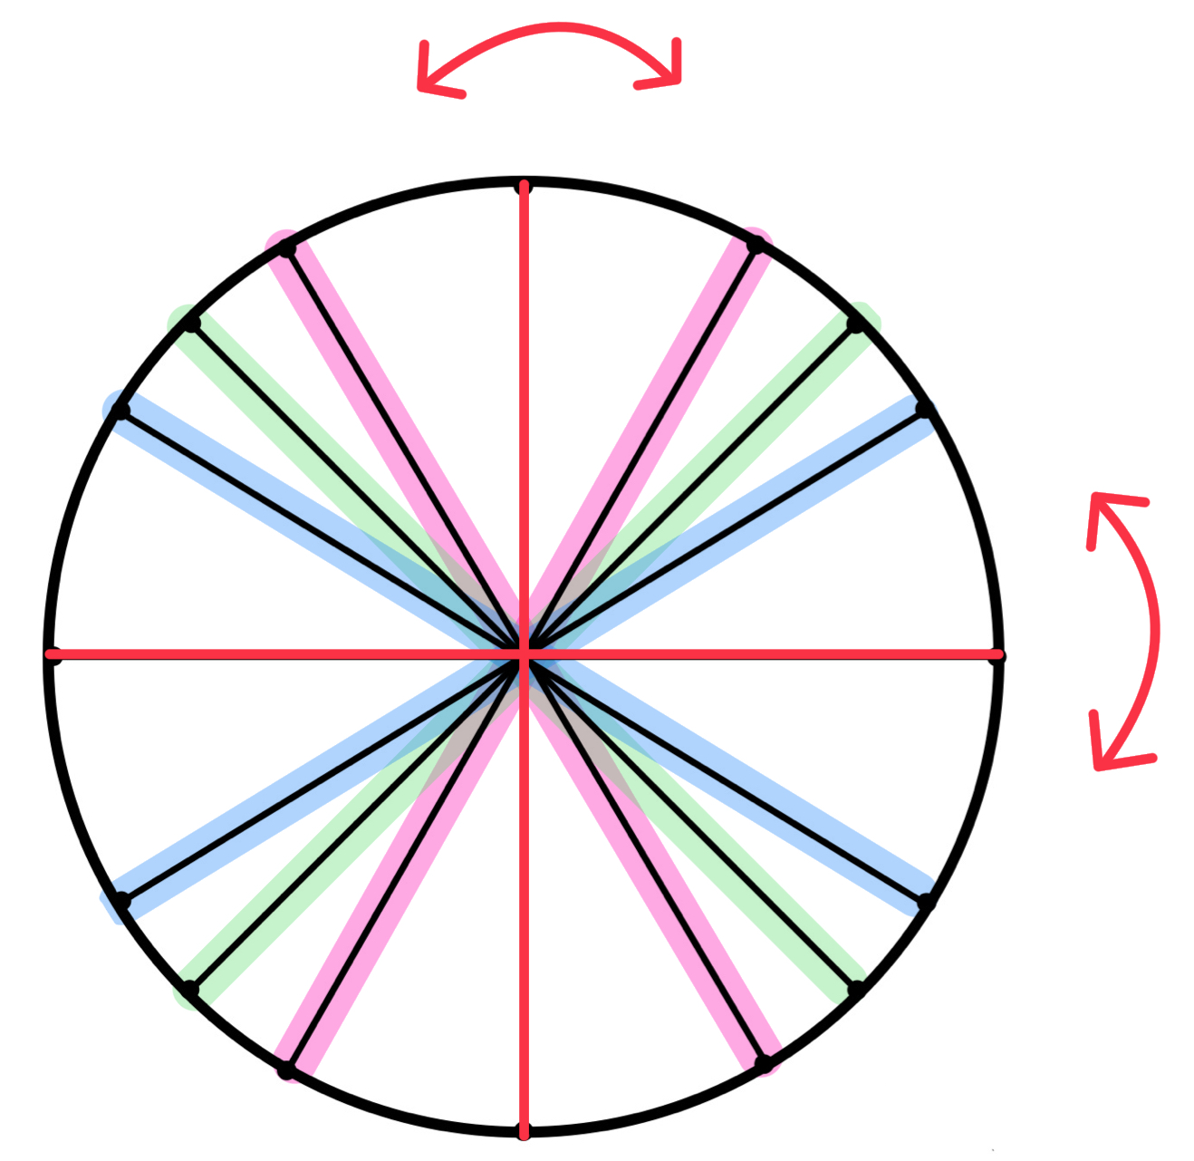
Step Six: mirror
across the axes

Slide 9
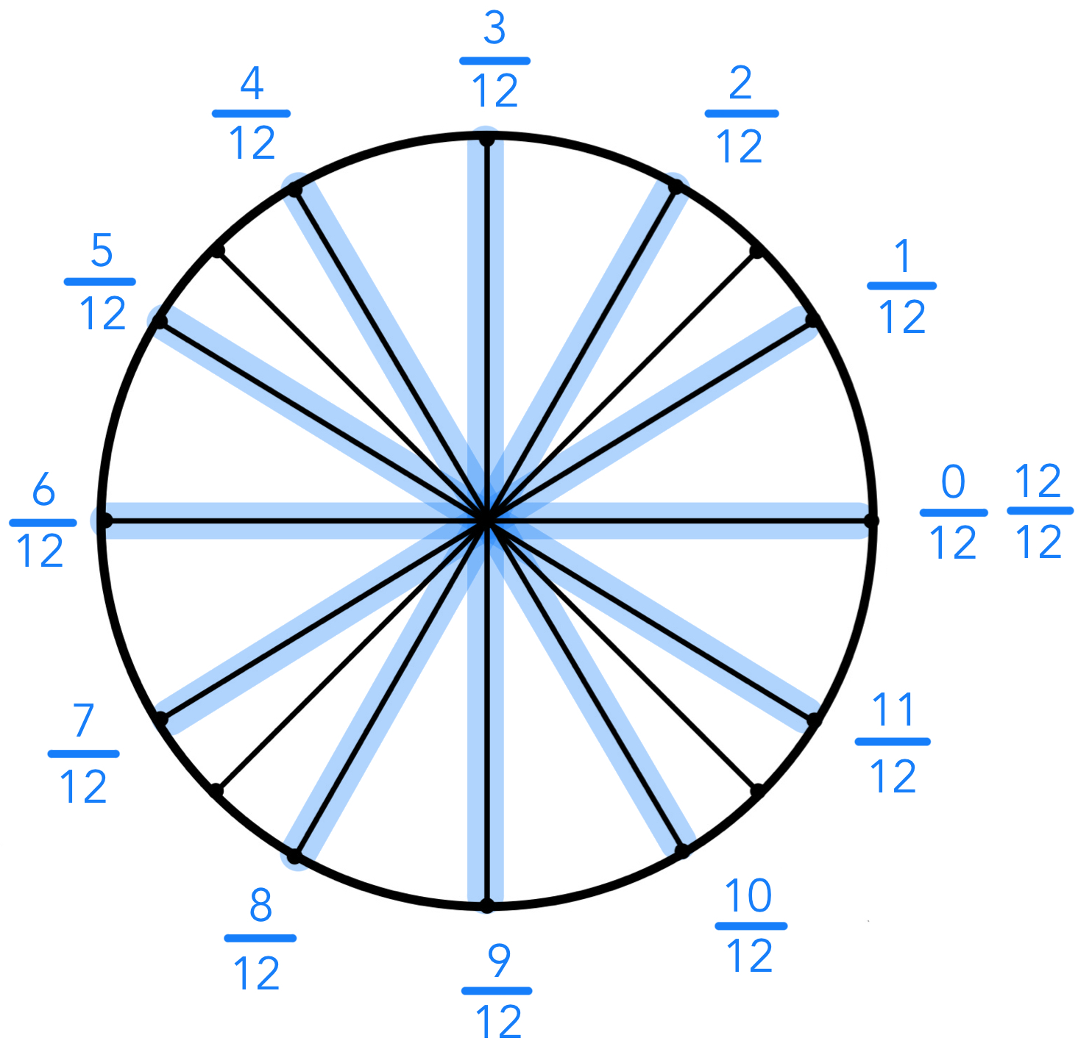
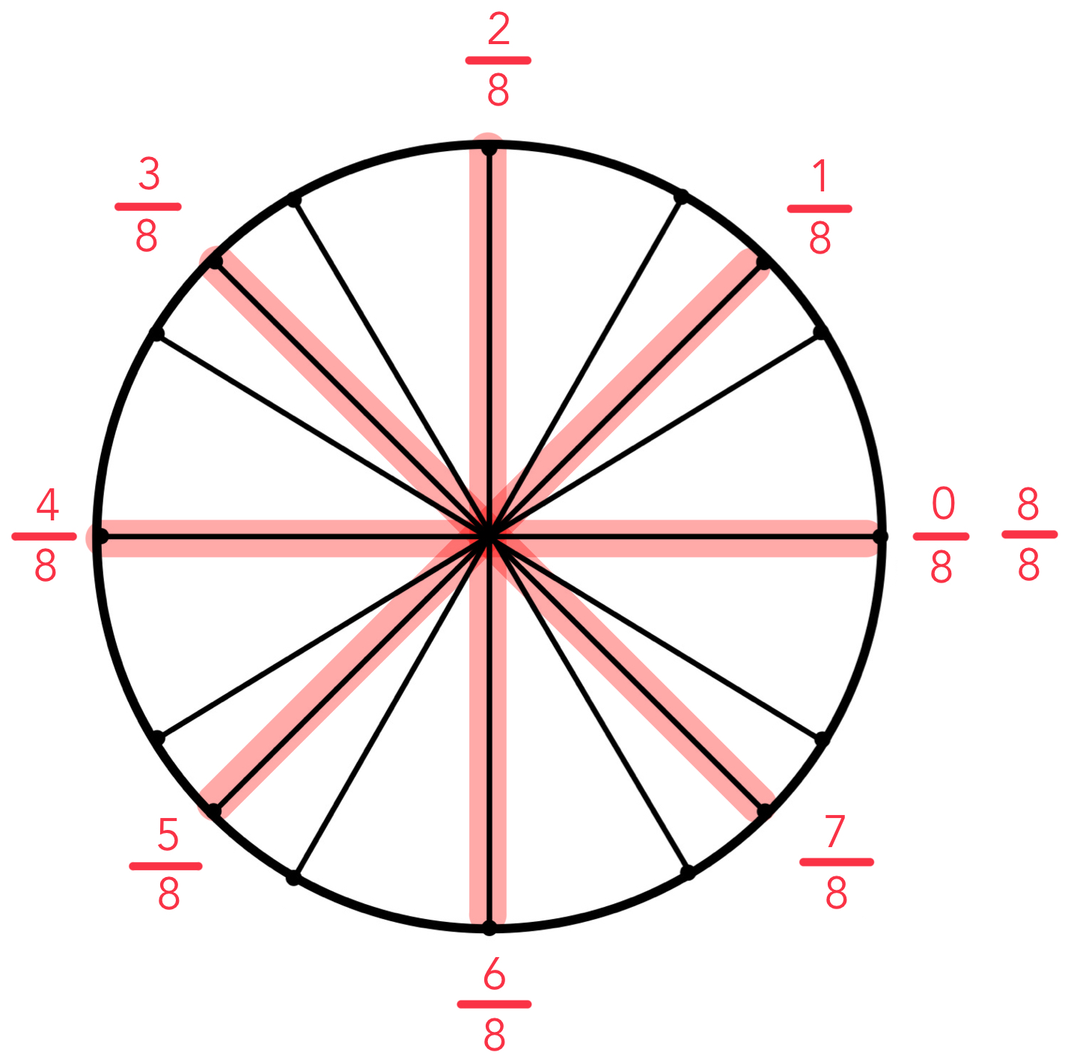
2pi
Step Seven: multiply to find angles

Slide 10
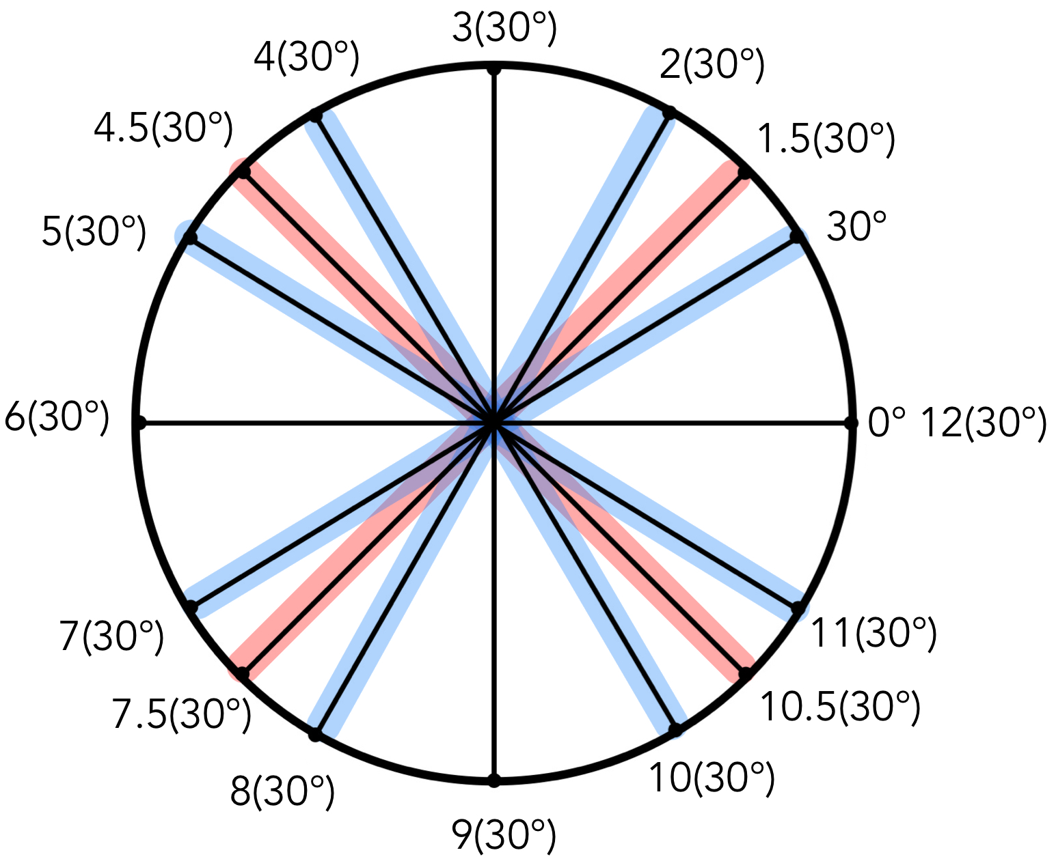
Step Seven: multiply
to find angles
30 deg.

Slide 11
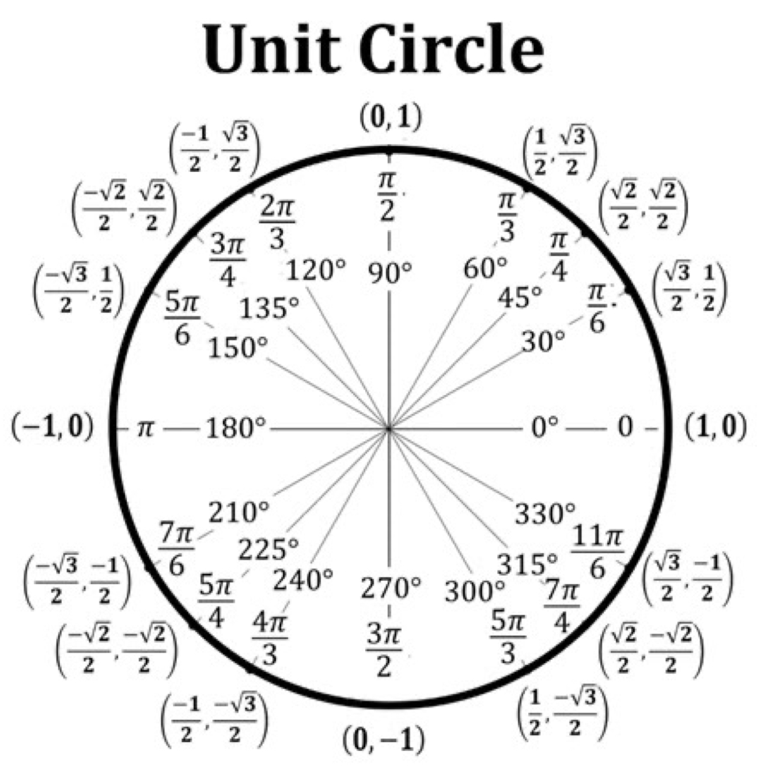
Done!

Slide 12
Worksheet

Slide 13
Any questions?

Slide 14
Thank you for coming!
Other test preps tonight:
Cydni 6-8pm Grant 107
Sophia 7-9pm Science 111 remember to eat, hydrate, rest, and relax. Good luck and study hard!

