Slide 1
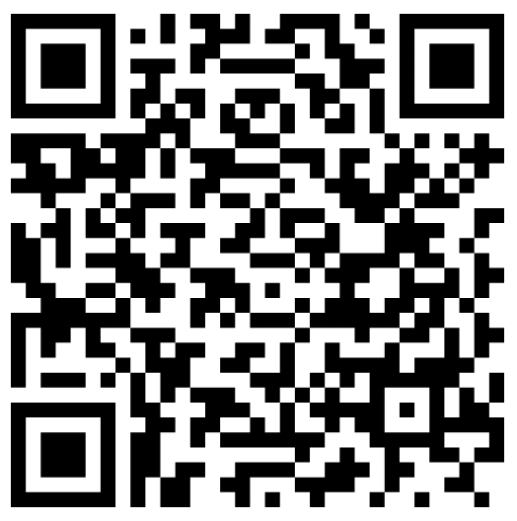
WELCOME TO
KEIRA Roberts’ math 2412 si test prep
Self-paced Blooket Warmup
Please sign in on the orange sheet at the front, grab a copy of the worksheet, and get started on today’s warmup by scanning the QR code.

Slide 2
AGENDA
Worksheet
Activity
Q & A

Slide 3
Worksheet

Slide 4
Any questions?

Slide 5
Activity

Slide 6
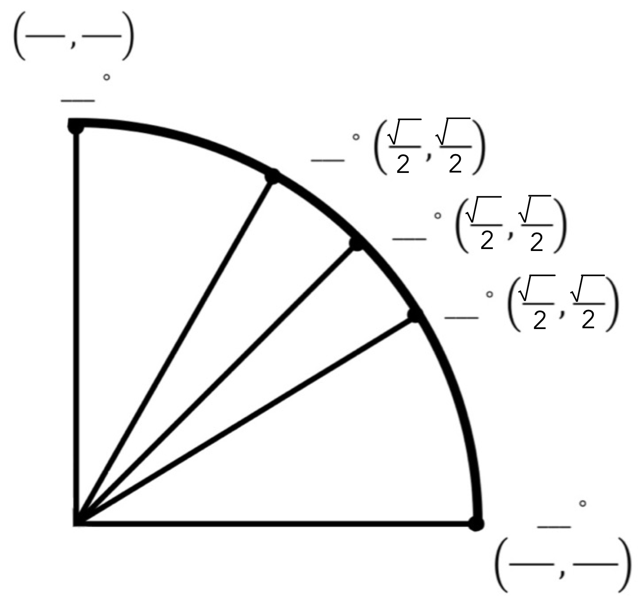
How to: Procedurally fill
The unit circle
Step One: fill in square root over 2

Slide 7
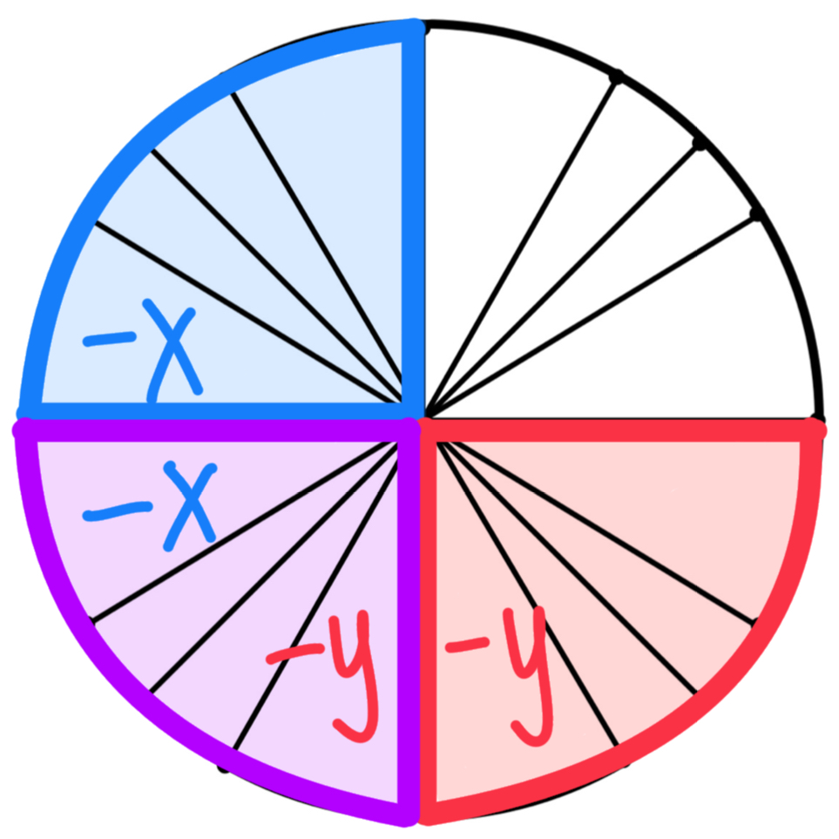
Step Two: fill in negative signs
Quadrant 1: ( x, y)
Quadrant 2: (-x, y)
Quadrant 3: (-x,-y)
Quadrant 4: ( x,-y)

Slide 8
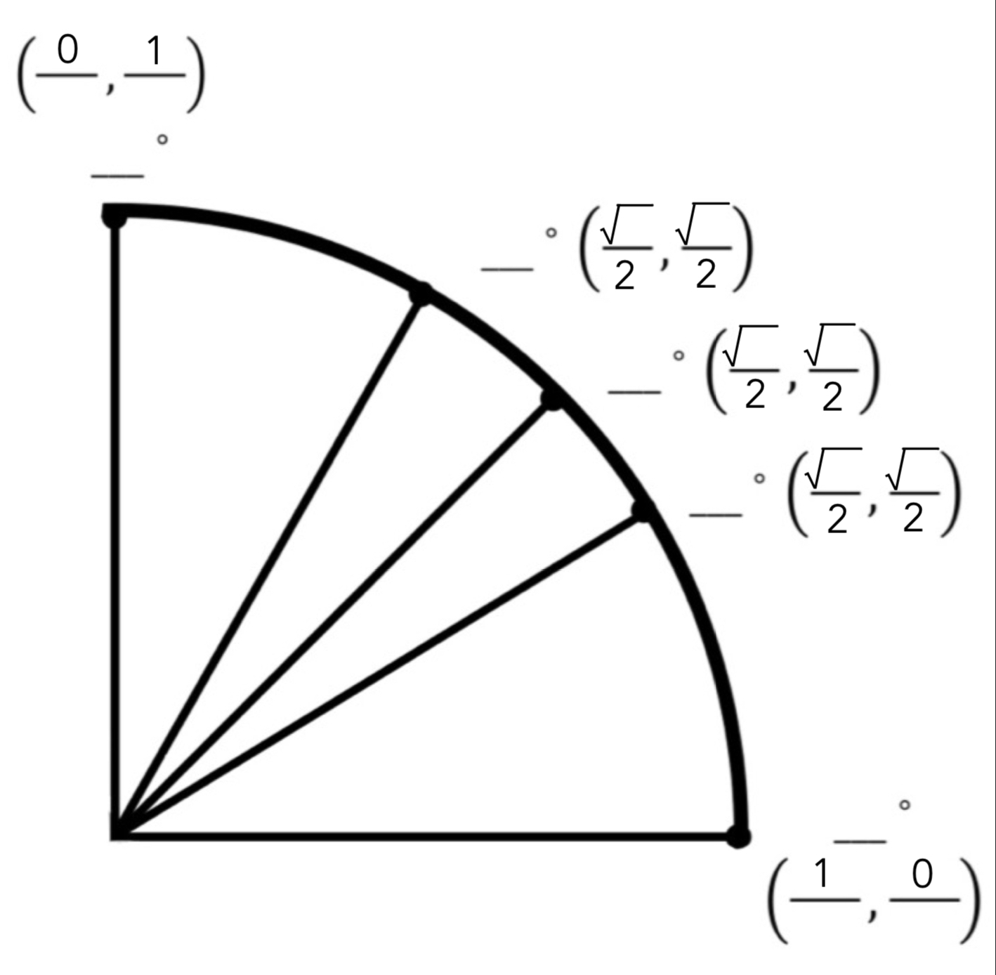
Step Three: fill in
( 1, 0)
(-1, 0) ( 0, 1)
( 0,-1)

Slide 9
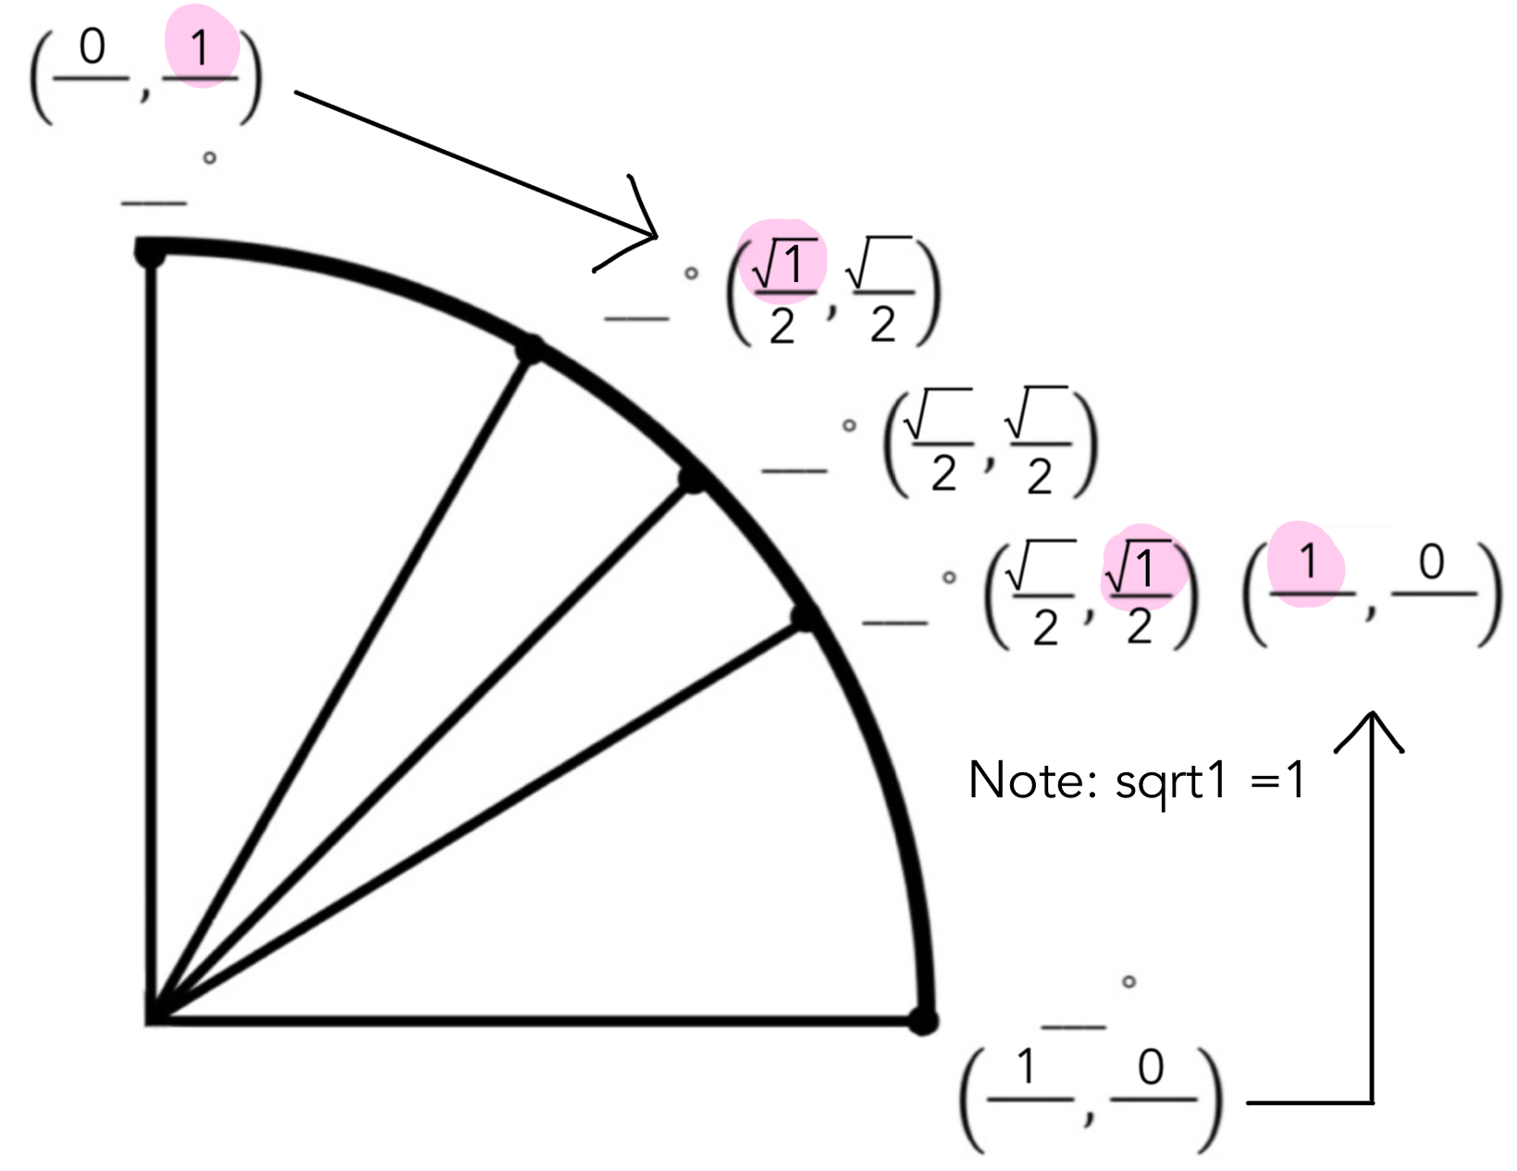
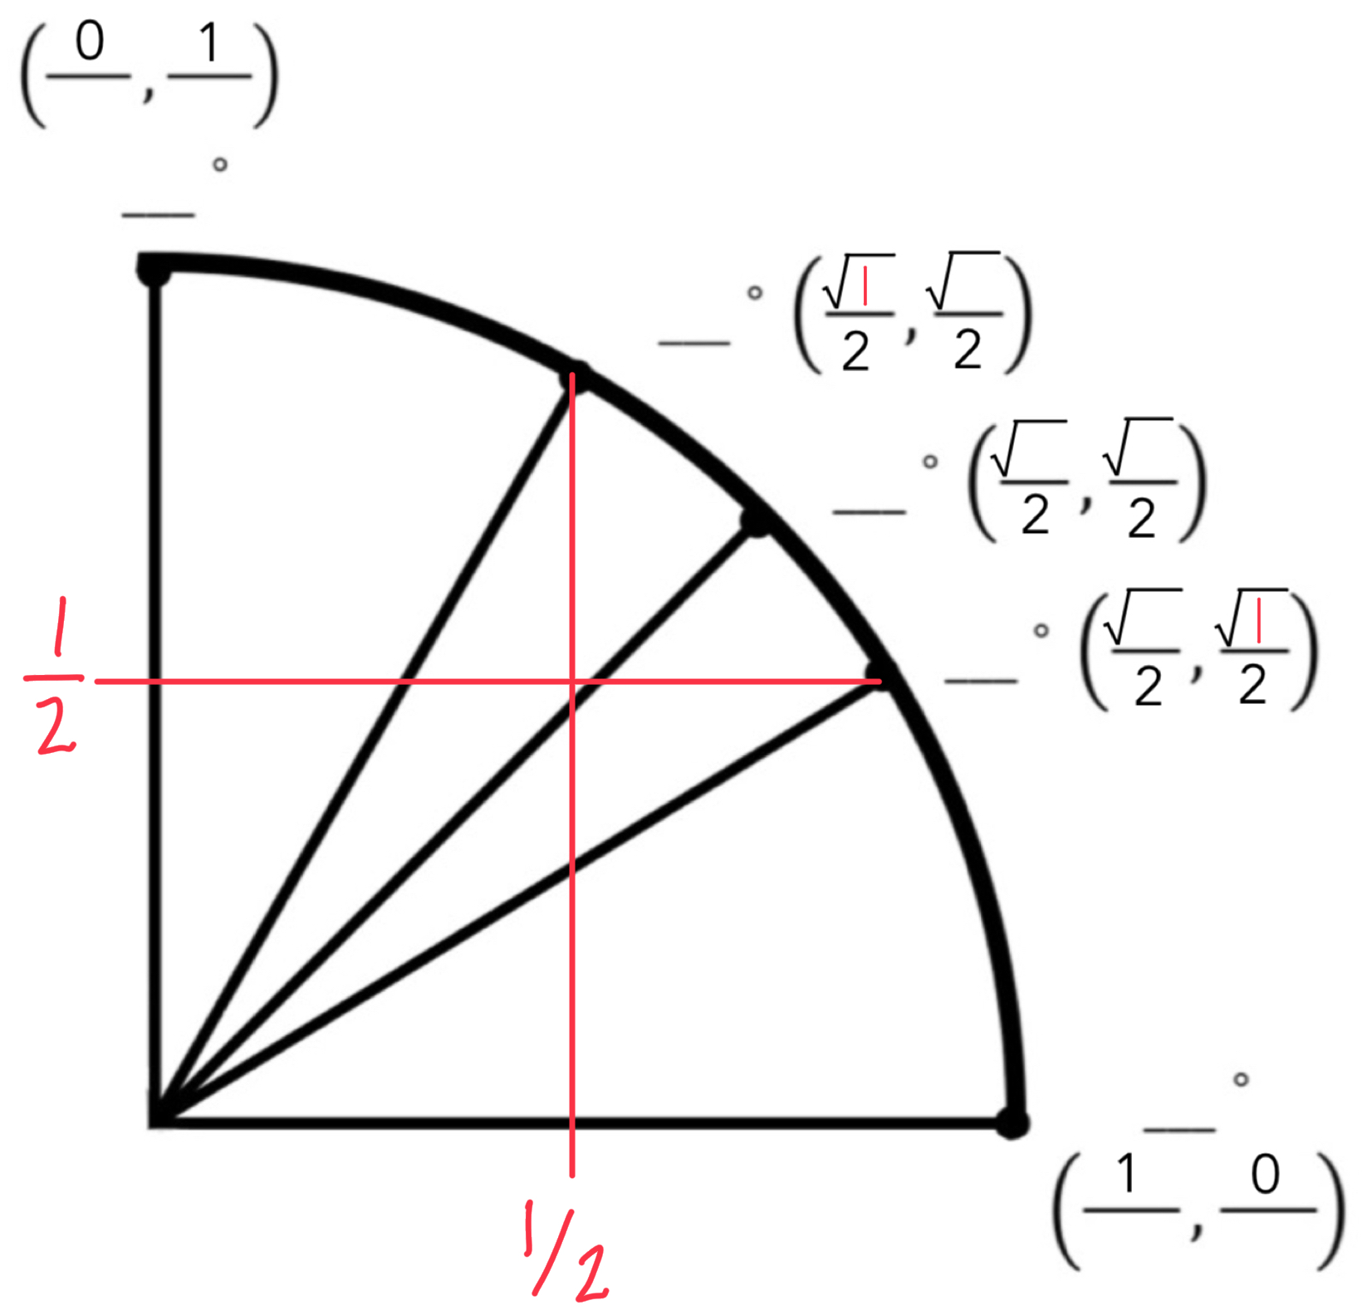
Step Four: 2 options to fill in 1’s
Option A: pair up 1’s
Option B: approximate ½’s

Slide 10
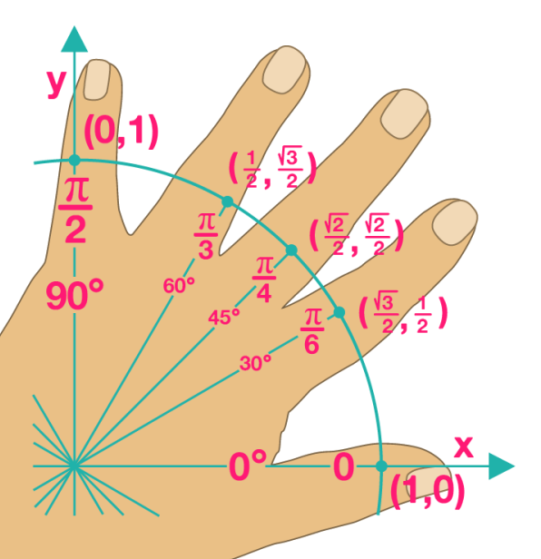
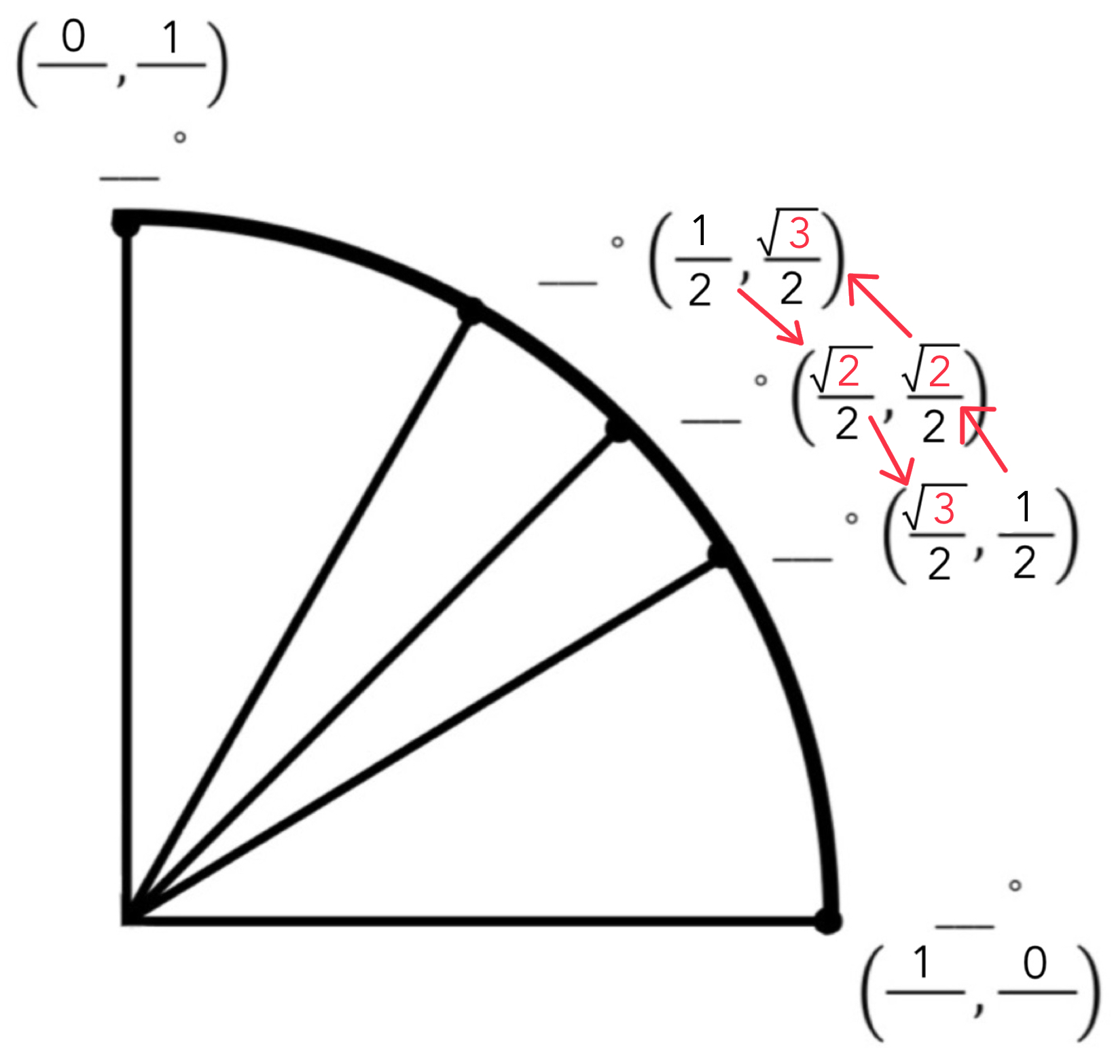
Step Five: 1 -> 2 -> 3
Or, use the left hand rule

Slide 11
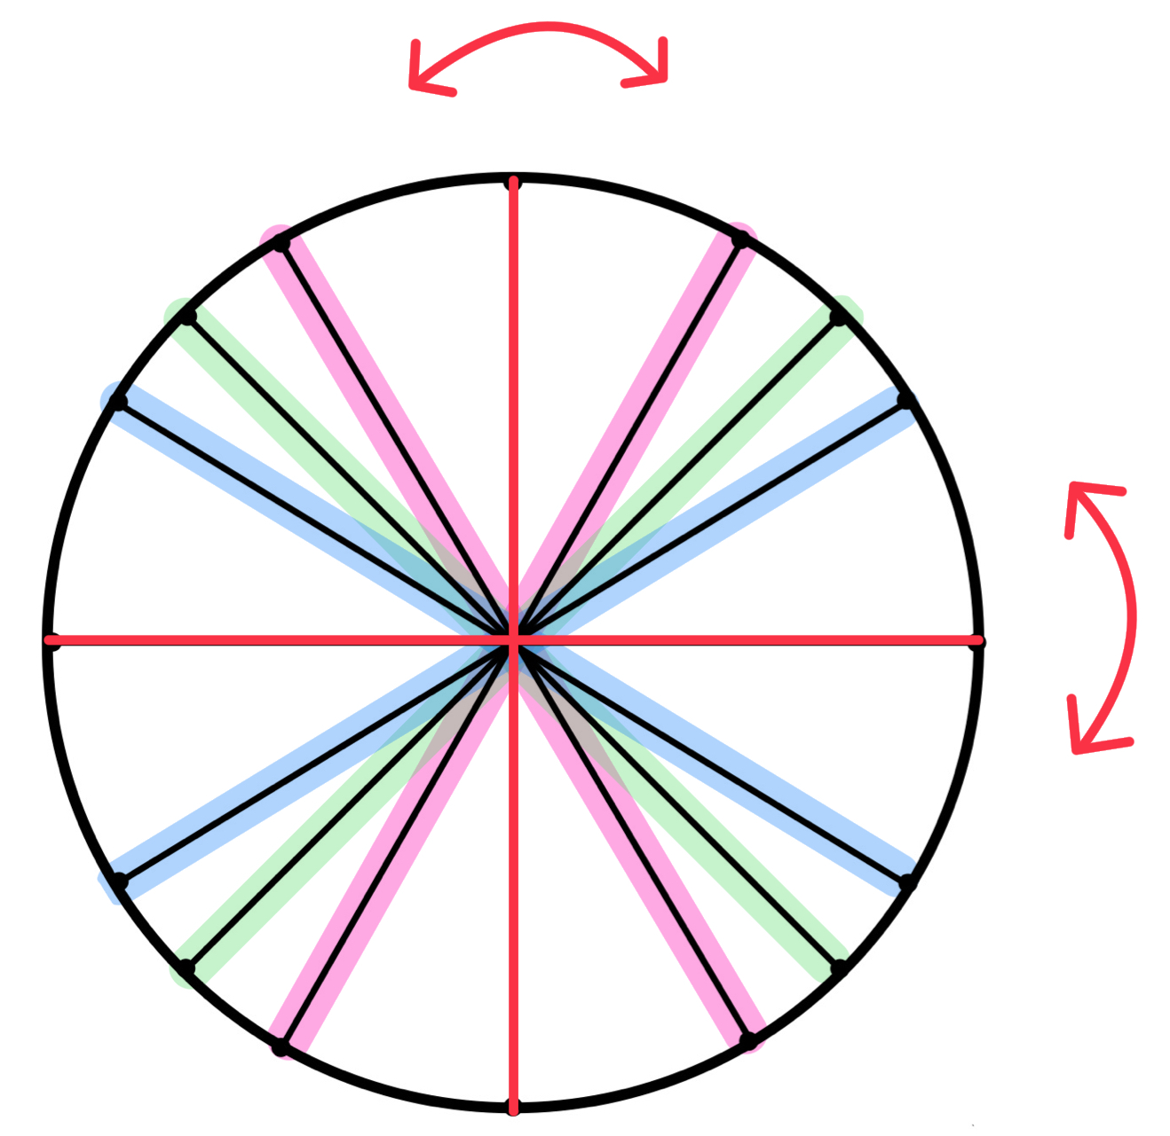
Step Six: mirror
across the axes

Slide 12
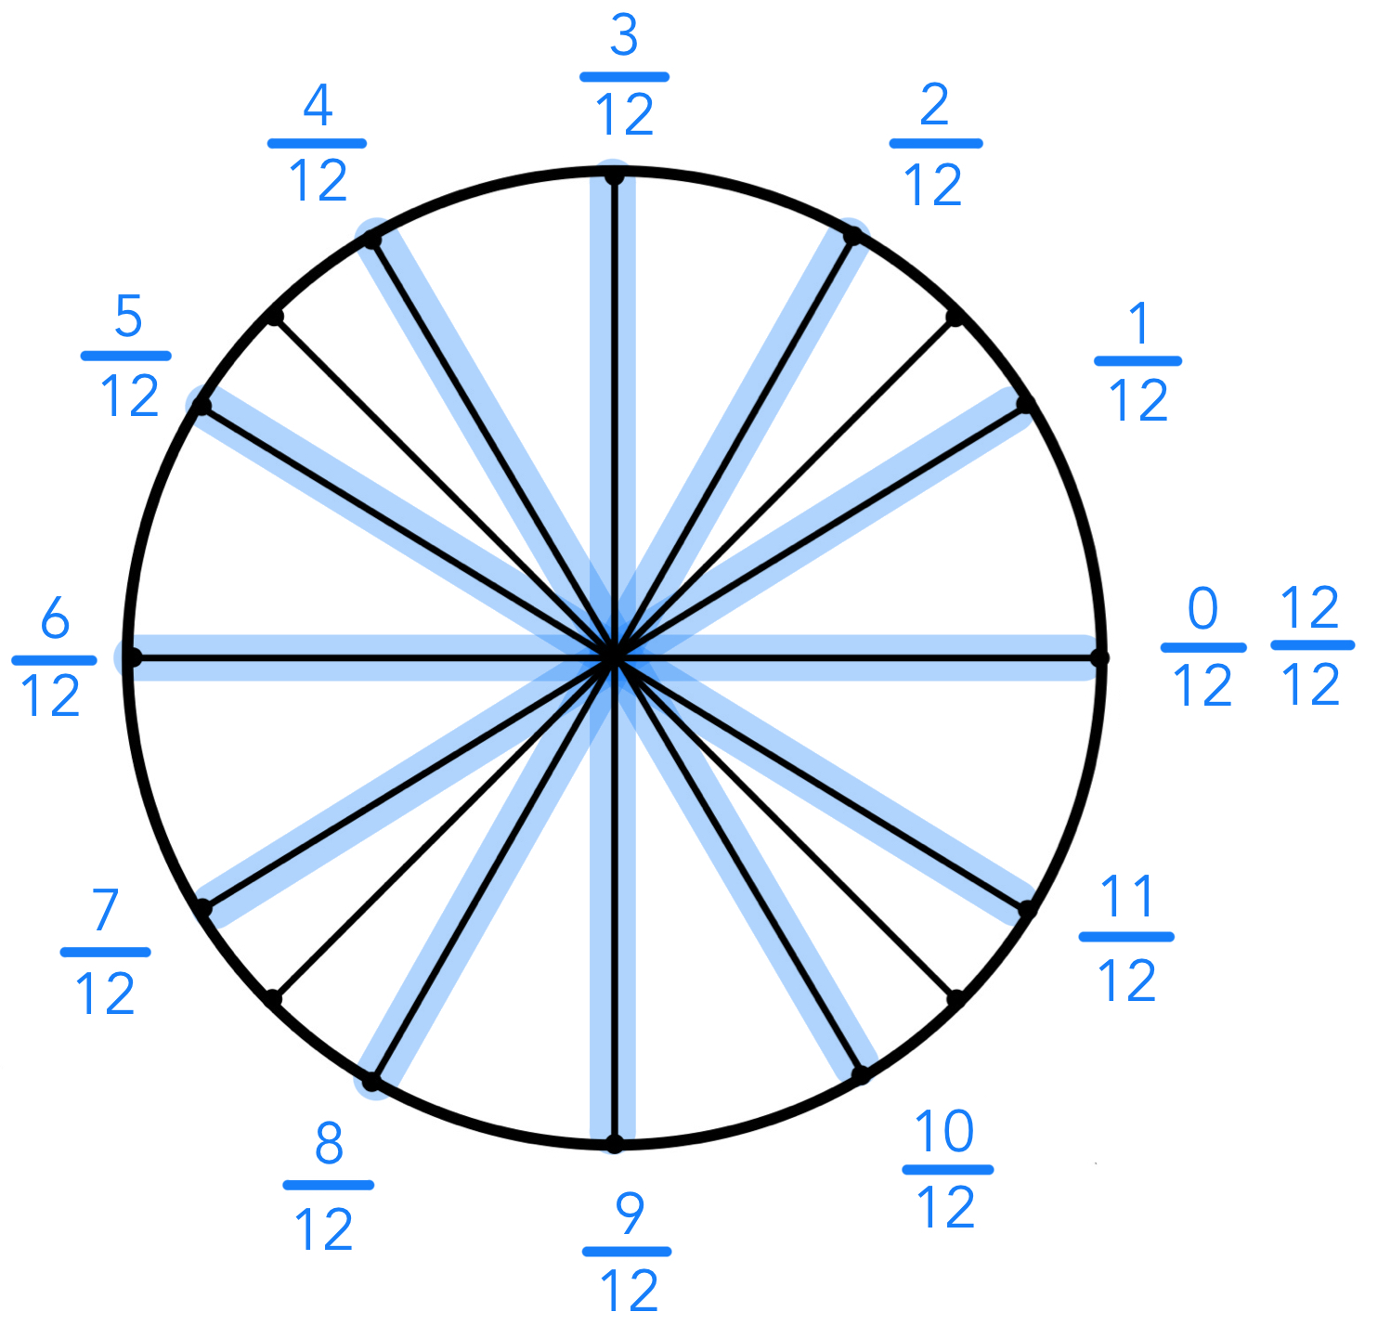
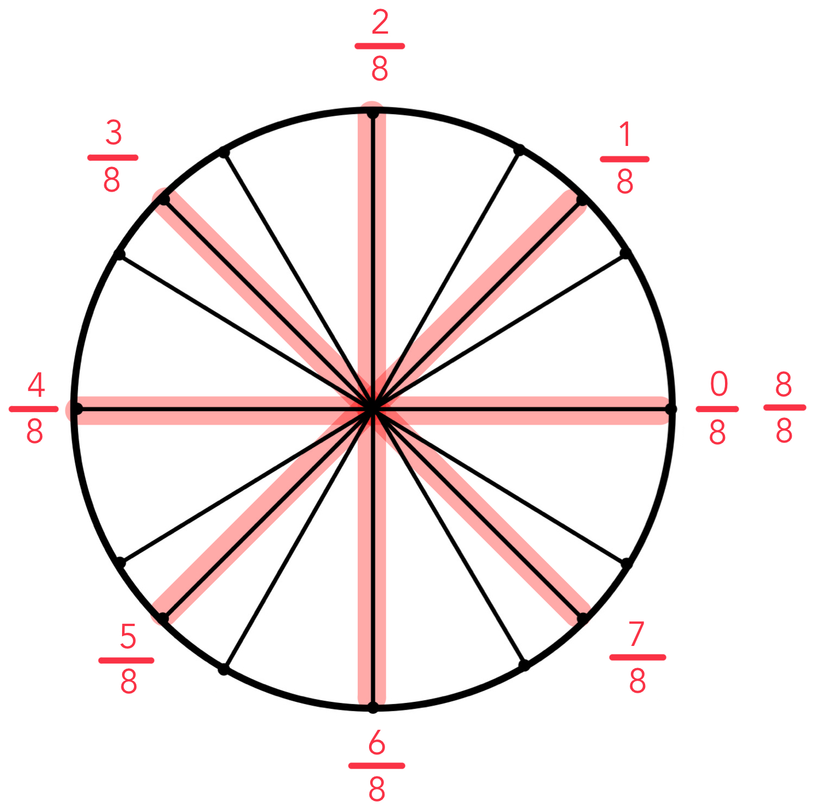
2pi
Step Seven: multiply to find angles

Slide 13
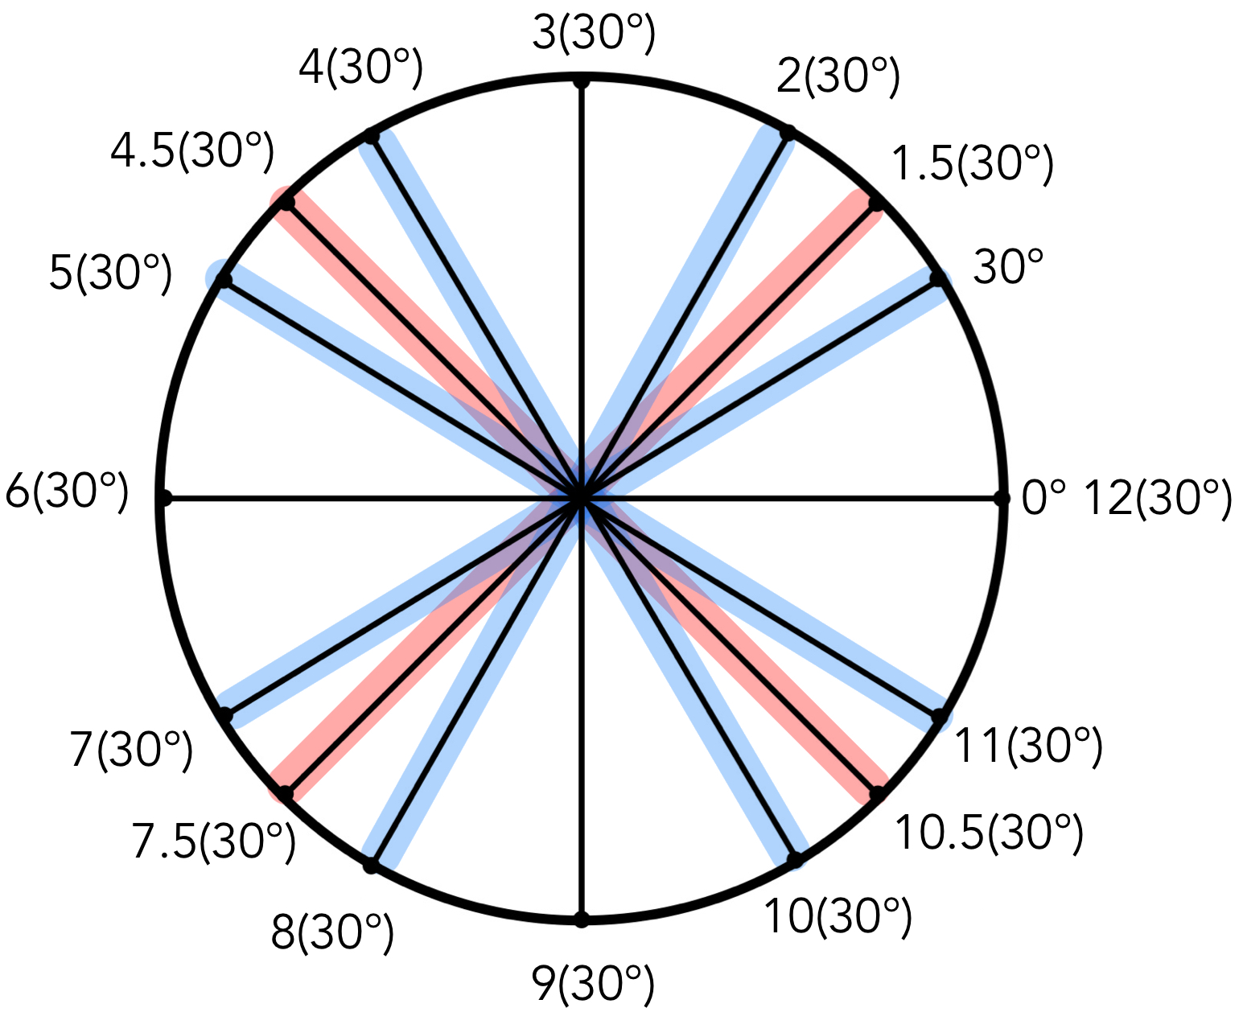
Step Eight: multiply
to find angles
30 deg.

Slide 14
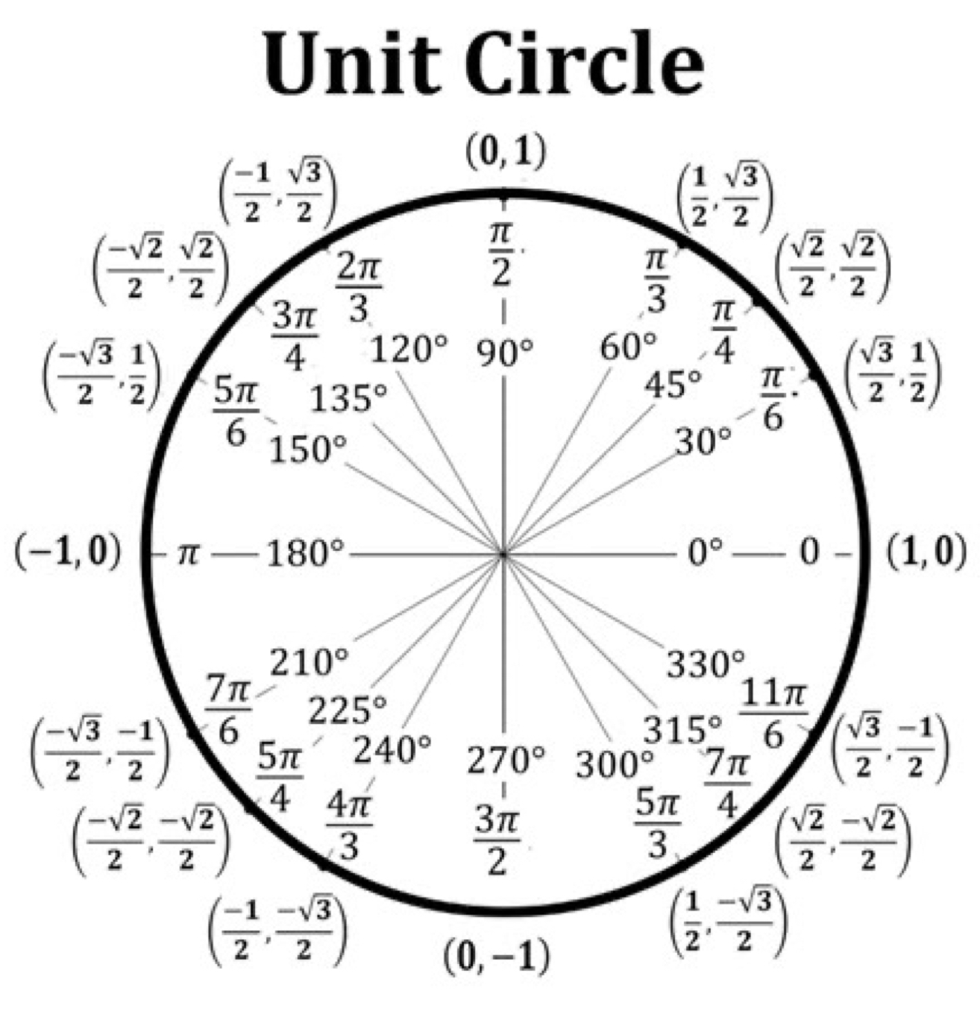
Done!

Slide 15
The Magic Hexagon of Trigonometry

Slide 16
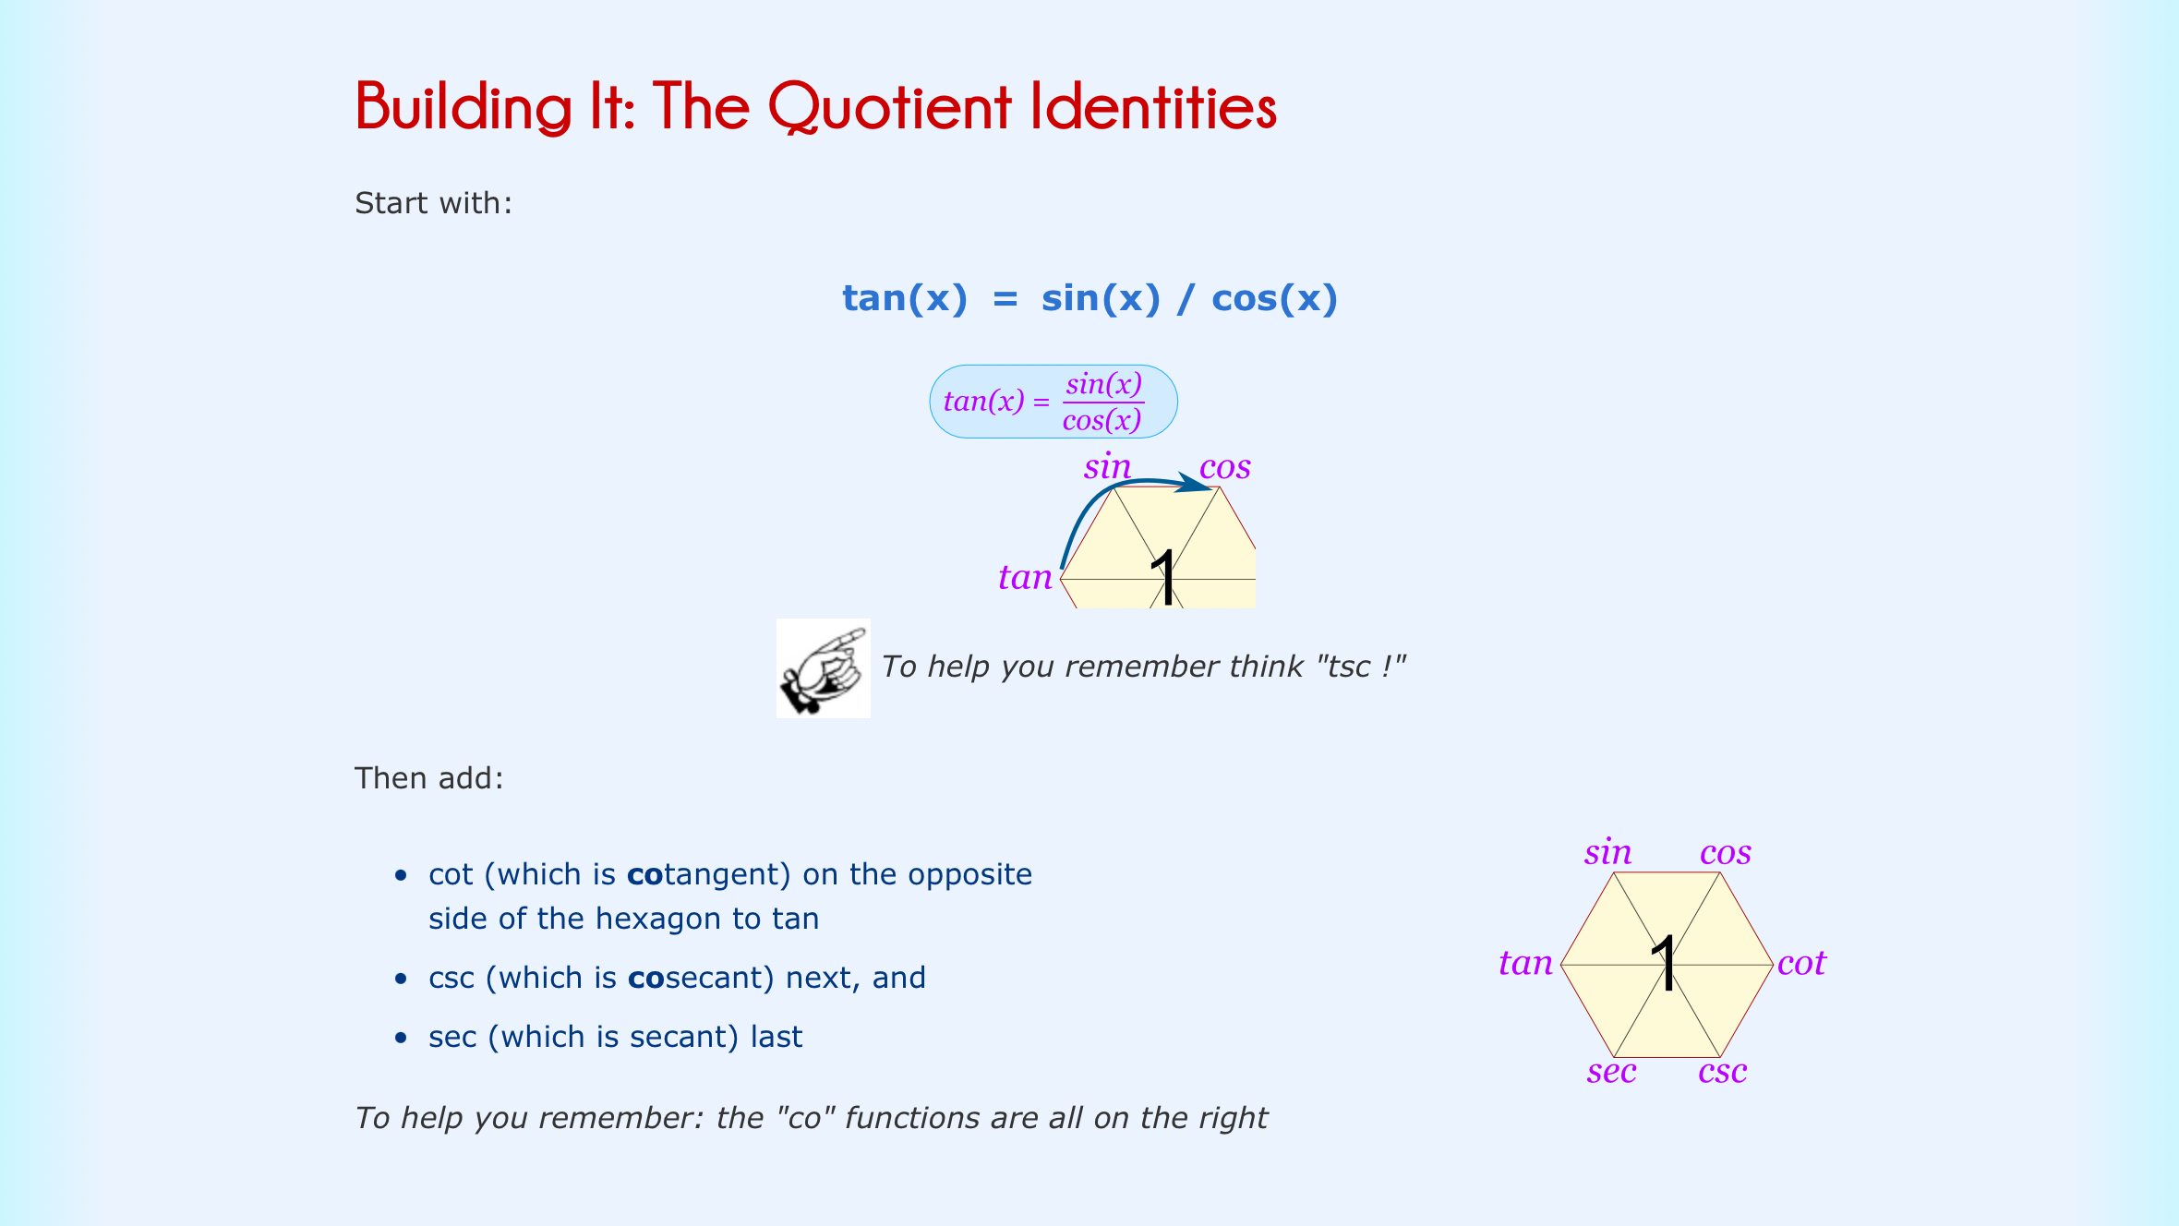

Slide 17
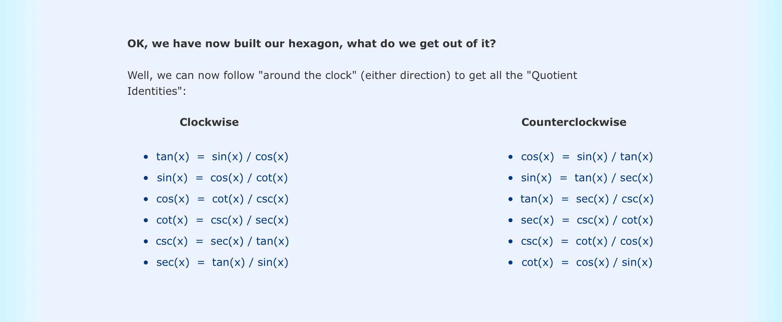

Slide 18
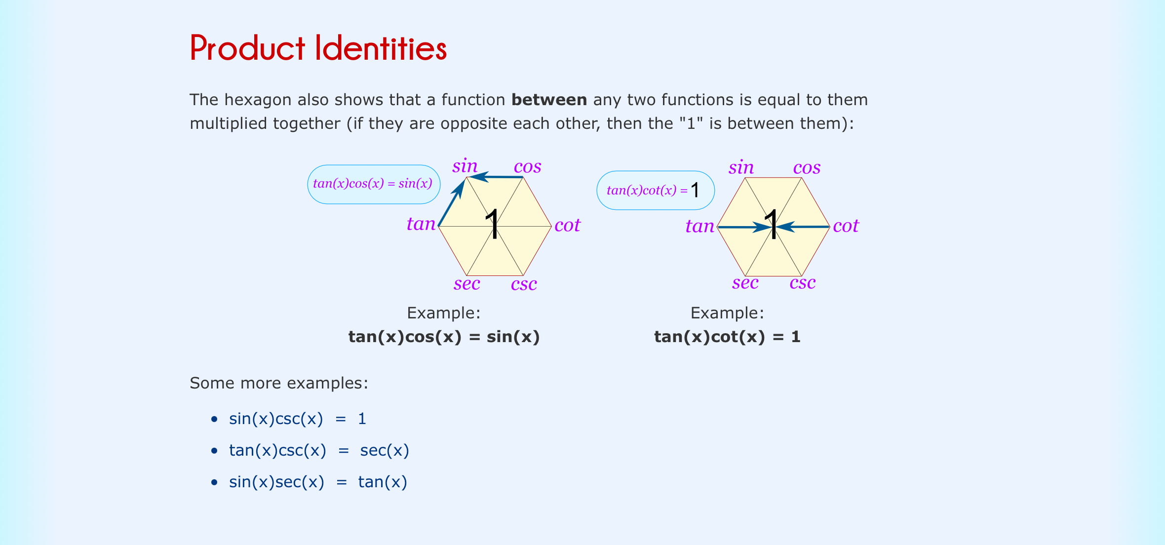

Slide 19
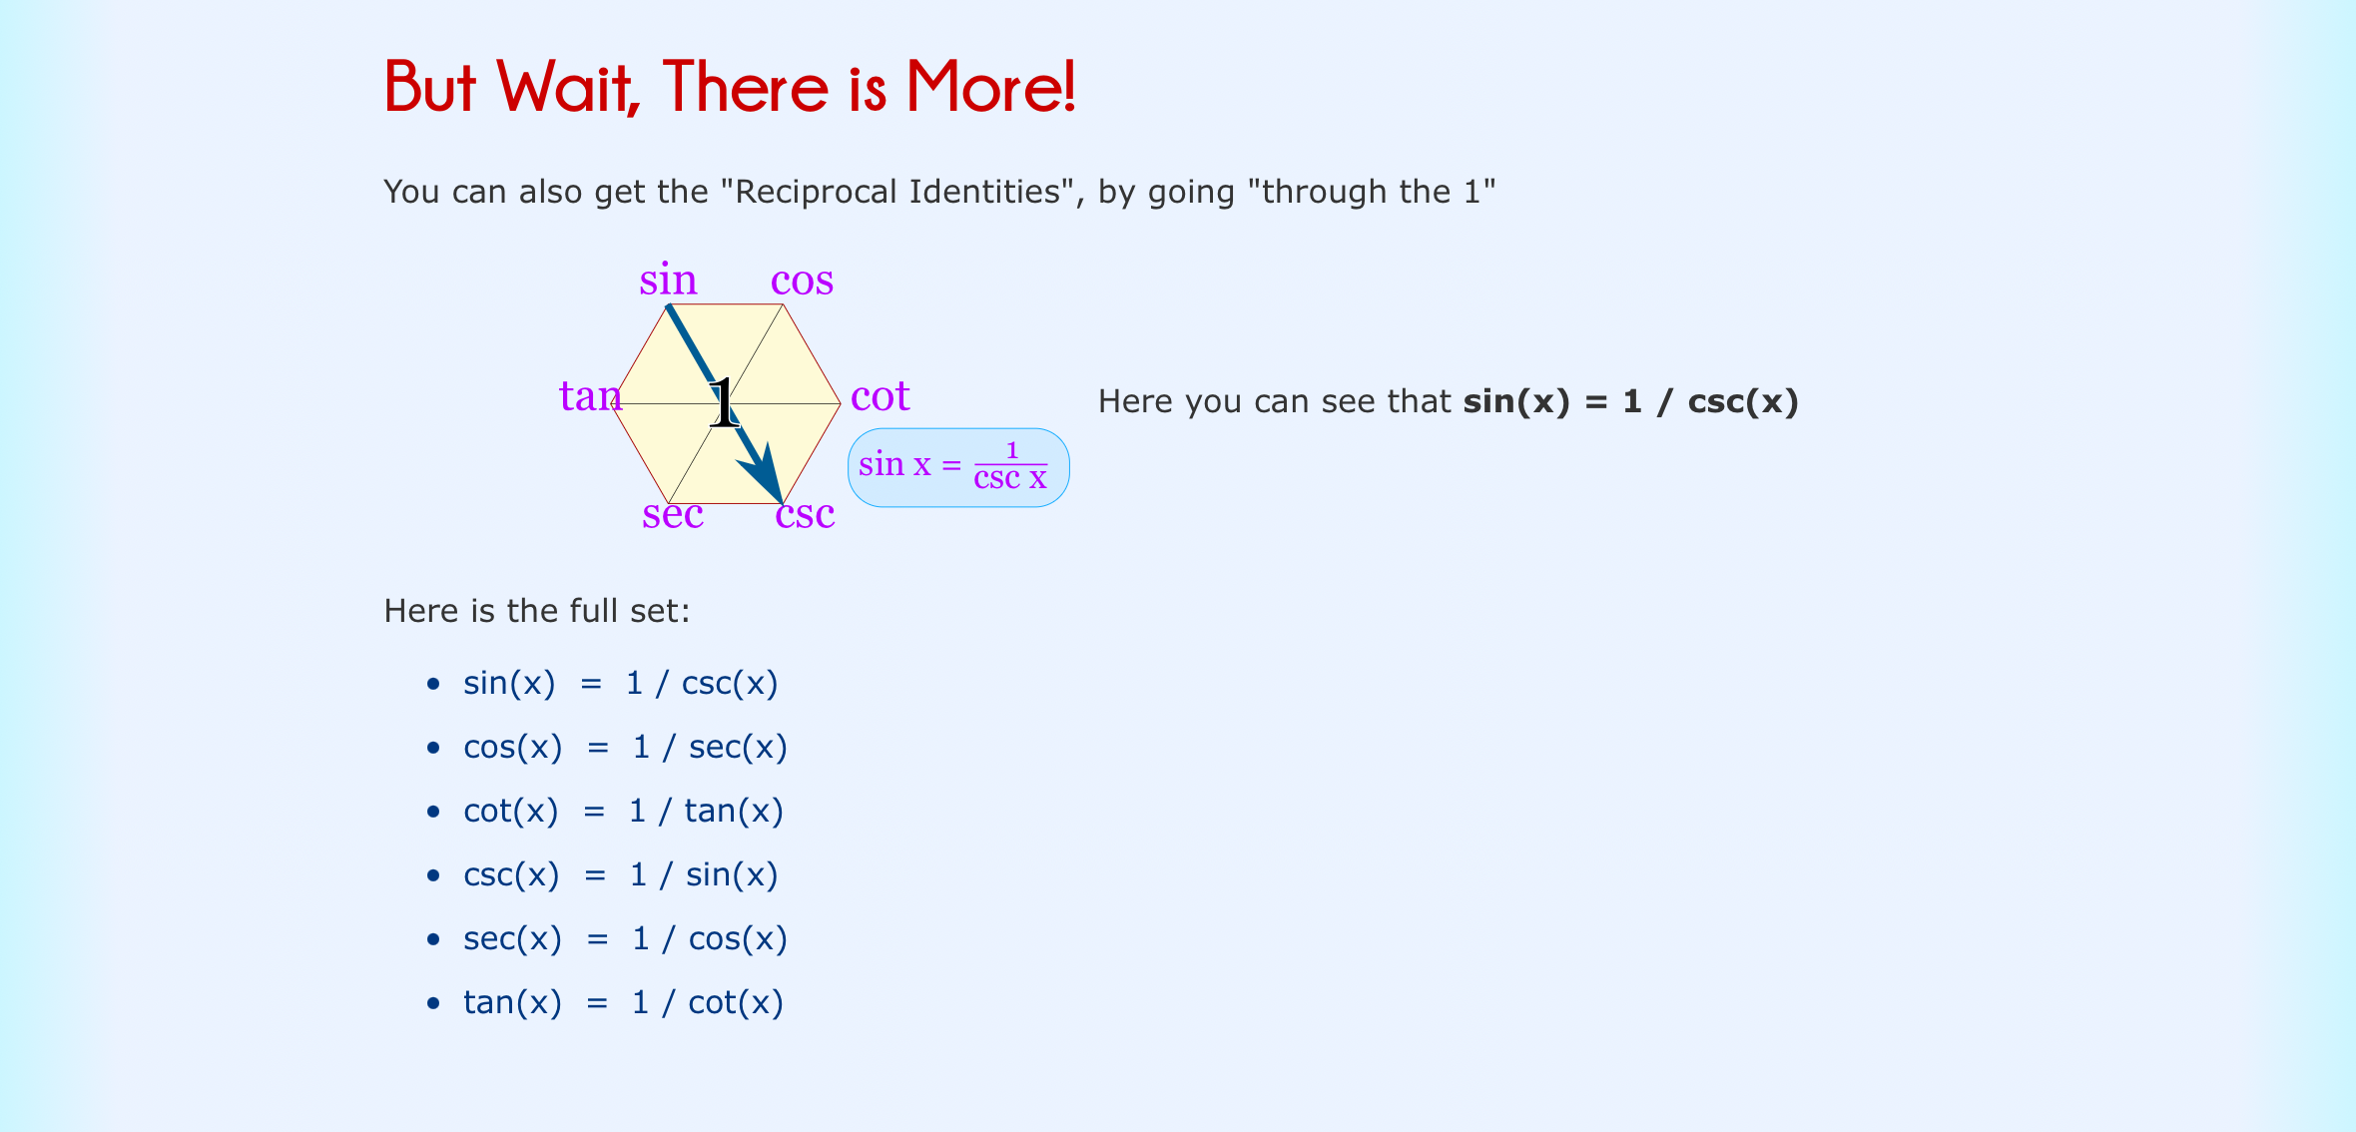

Slide 20
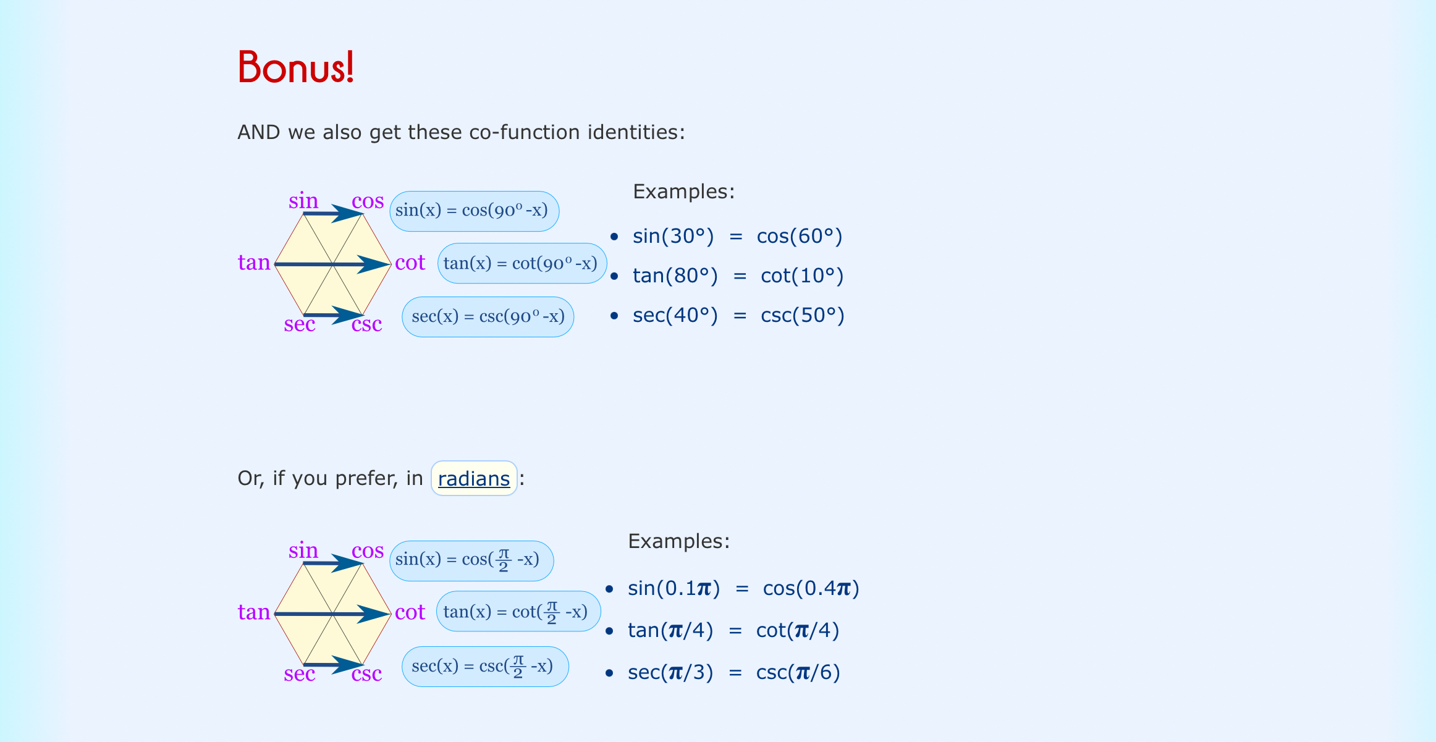

Slide 21
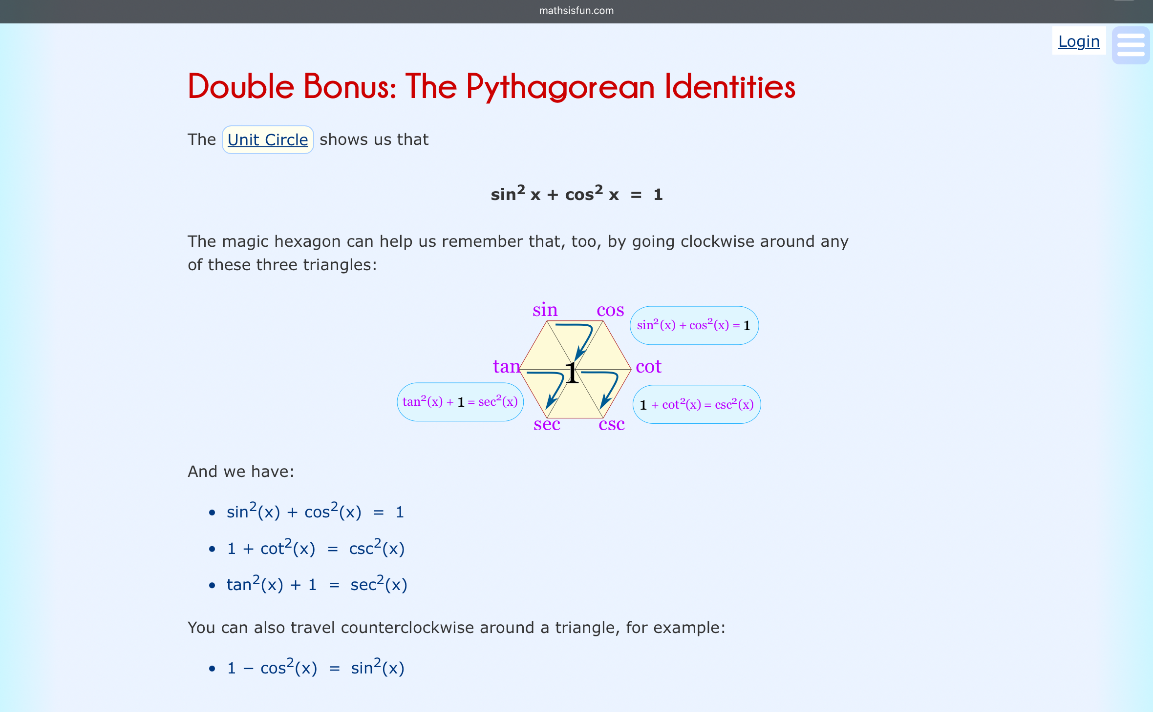

Slide 22
Thank you for coming!
More test prep:
Cydni Thursday 6-8 Grant 107 remember to eat, hydrate, rest, and relax. Good luck and study hard!
Google “Keira Roberts SI” to find my website with keys, Recordings, and my contact info if you have any questions.

