Slide 1
Please sign in on the orange sheet at the front, grab a copy of the worksheet, and solve Today’s warmup question:
What angle between 0-360 is coterminal with 855 degrees?
Welcome to
Keira Roberts’
Math 2412 si

Slide 2
TRIG GRAPHS Activity
For each graph, we will determine the
-parent function
-horizontal shift
-vertical shift
-amplitude
-Period or repeating asymptotes
Then we will create the equation.

Slide 3
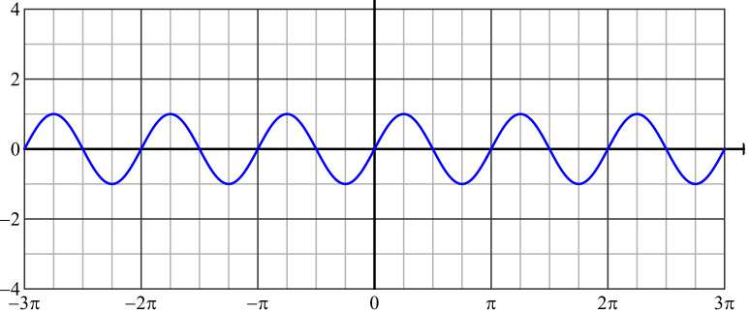
Parent function
Horizontal shift
Vertical shift
Amplitude
Period
Equation

Slide 4
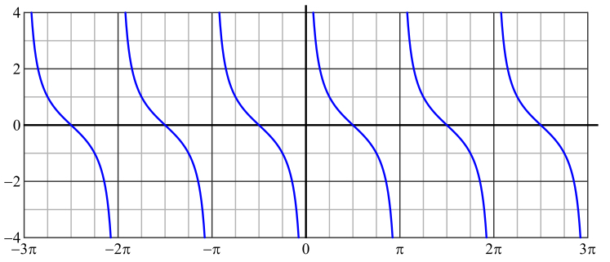
Parent function
Horizontal shift
Vertical shift
Amplitude
asymptotes
Equation

Slide 5
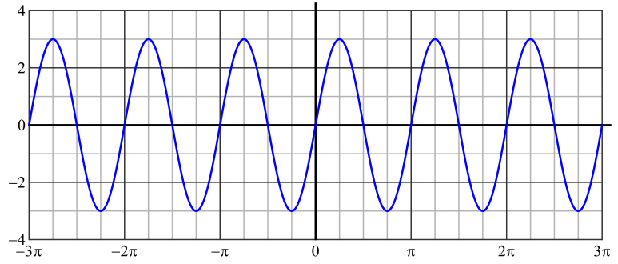
Parent function
Horizontal shift
Vertical shift
Amplitude
Period
Equation

Slide 6
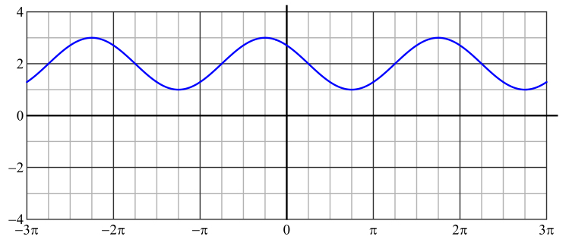
Parent function
Horizontal shift
Vertical shift
Amplitude
Period
Equation

Slide 7
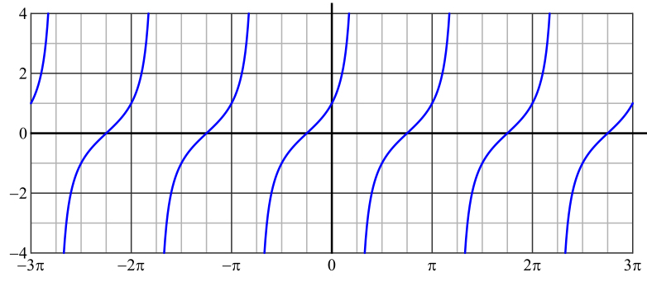
Parent function
Horizontal shift
Vertical shift
Amplitude
asymptotes
Equation

Slide 8
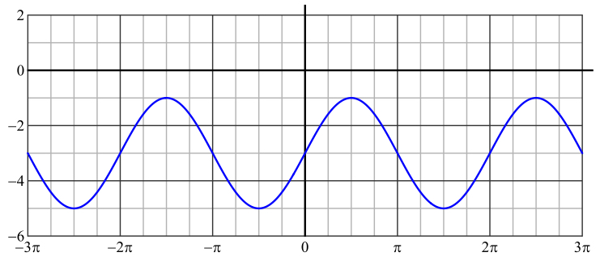
Parent function
Horizontal shift
Vertical shift
Amplitude
Period
Equation

Slide 9
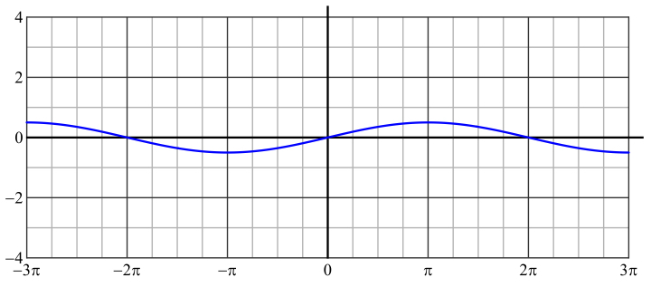
Parent function
Horizontal shift
Vertical shift
Amplitude
Period
Equation

Slide 10
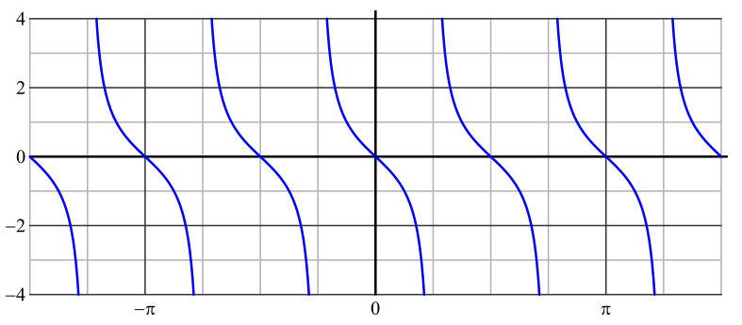
Parent function
Horizontal shift
Vertical shift
Amplitude
asymptotes
Equation

Slide 11
Calculating Asymptotes worksheet

