Slide 1
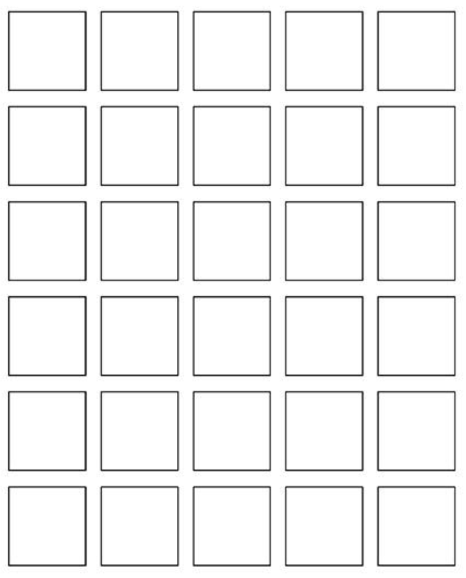
Welcome to
Keira Roberts’
Math 2412 SI
Warmup: Wordle
Please sign in on the orange
sheet at the front and grab
a copy of the worksheet.
A B C D E F G
H I J K L M
N O P Q R S T
U V W X Y Z
Notes:
ratio

Slide 2
WORKSHEET

Slide 3
ACTIVITY

Slide 4
SCHEDULE
Your unit 5 exam is on Tues 11/25!
Wednesday, November 19th- Last Regular Session
4-5 pm in Math 134
Monday, November 24th- My Last Test Prep Session
4-6 pm in Math 134
Monday, November 24th- Cydni’s Last Test Prep Session
6-8 pm in Room TBA
What is FSP?
-free study help
-for MOST courses
-prepare for finals
-no appointment needed!
10 am to 5 pm
Tuesday, December 2nd- Finals Study Prep (FSP)
MATH 2412 specifically: 11 am - 5 pm
in the Tutoring & Learning Center (Library Basement)
*Please check in with the office and they will
get you connected with the right person!*
Wednesday, December 3rd- Finals Study Prep (FSP)
MATH 2412 specifically: 3:30 pm - 5 pm
in the Tutoring & Learning Center (Library Basement)
*Other MATH SI leaders and Math Tutors
should be available at any time 10 am – 5 pm!*
The FINAL EXAM for MATH 2412 is on FRIDAY, DEC 5th from 3:30 to 5:30 pm

